Slide 1
VOTER PROTECTION
OVERVIEW
Erica Peresman and Dorian Tyus
MDP Voter Protection Team
March 2021

Slide 2
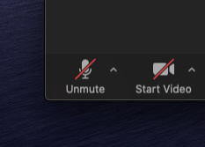
Zoom
Please be muted unless you have a question or comment

Slide 3
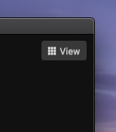
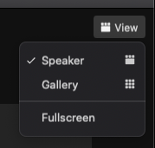
Zoom
Click “Speaker View” so that you can see my screen

Slide 4
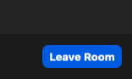
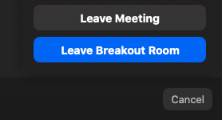
Zoom
Return to main room before next set of breakout sessions

Slide 5
The Voter Pro Program

Slide 6
OUR VISION
Every voter
is able to cast a ballot
that counts!

Slide 7
Three Buckets
Poll Observing
Voter Education and Assistance
Advocacy

Slide 8
Main Activities
Engage with state and local election administrators to improve access to voting.
Recruit and train volunteers to serve as poll observers at polling places, local clerk’s offices, satellite clerk’s offices and absentee ballot counting locations.
Run a Voter Assistance Hotline (staffed by volunteers), and prepare educational materials for voters.
Assist voters and help ensure a fair election by tracking and responding to voting problems that arise.

Slide 9
Poll Observing

Slide 10
A Note on Terminology
“Poll Observer” is a generic term for individuals who observe voting and absentee ballot counting.
In Michigan, two types of poll observers:
Challengers:
Credentialed
Have special rights under Michigan law -- can stand behind processing tables and can object if election inspectors (paid poll workers) are not following the law
Must be registered to vote in Michigan
Poll Watchers:
Not credentialed
Must stay in the public area and cannot object if election inspectors are not following the law
Need not be registered to vote in Michigan
MDP focuses on challengers because of their ability to intervene and prevent voter suppression.

Slide 11
Challengers: the Heart of our Program
Our eyes and ears on the ground to make sure that voters are able to cast a ballot that counts.
Early Voting: Volunteers monitoring early voting at clerk’s offices and satellite offices during the 40 days before Election Day
Election Day: Volunteers monitoring
Polling places
Absentee Counting Boards
Clerk’s offices and satellite offices

Slide 12
Plans for 2021 and 2022
Recruit and train challengers for a limited number of municipal elections in 2021
Recruit and train challengers statewide for 2022
Continue training specialized teams of challengers to observe in absentee counting rooms
Training will be virtual, but local groups may wish to supplement with in-person if feasible

Slide 13
Voter Education and Assistance

Slide 14
Voter Assistance Hotline and Voter Education
Hotline (833-MI-VOTES) operated from mid-January through mid-November 2020
Hotline will be reactivated in June 2021 and will operate through the November 2022 election
MDP monthly webinar addresses voter education topics
VotePro team will work with Comms team on voter education materials for 2021 and 2022
Everyone can help by spreading good information to combat disinformation

Slide 15
Advocacy

Slide 16
Municipal, State and National Levels
Local Voter Protection Leads in 80 priority municipalities are key: they know their communities and their election officials
2021 priority: analyzing data from 2020 poll observing and discussing issues with clerks
Tracking Michigan legislation and working with Democratic legislators and allies on problematic bills
Helping to further Secretary Benson’s legislative agenda
Advocating for expansion of voting rights at the national level

Slide 17
Contact Information
for the Voter Protection Team
Erica Peresman, Voter Protection Director
eperesman@michigandems.com
248-701-3909
Dorian Tyus, Deputy Voter Protection Director
dtyus@michigandems.com
248-802-4182

