Slide 2
Rules for
Voting and Elections

Slide 3
Overview
State Allocation of Delegate Vote (SADV)
Weighted Voting
Single Position Offices
Majority Voting Method Example
Multiple Position Offices
Slate Voting Method Example
Geographical Distribution Method Example

Slide 4
Overview
These rules provide procedures to be used for all voting and elections at the various levels of the Michigan Democratic Party: State Convention, Congressional District caucuses, conventions, and meetings, County conventions and meetings, and meetings of constituency caucuses or clubs which are chartered by the MDP or one of its units. No other voting procedures are approved for use within the MDP.

Slide 5
General Principles
Votes shall not be taken by secret ballot at any meeting of the Democratic Party in Michigan at any level.
All votes in methods described below may be cast by show of hands or a rising vote at the Chair’s discretion.
No rule shall be adopted by any MDP unit that would require any person to cast a vote or be recorded as voting contrary to that person’s judgment.
The Unit Rule (the practice of a unit reporting a unanimous vote when the vote within that unit was not unanimous) shall be prohibited in all units.

Slide 6
SADV
SADV: State Allocation of Delegate Vote – the numerical weight or voting strength given to a county’s delegates at a convention, caucus, or meeting, proportional to the Democratic voting strength of that county relative to the state as a whole at the last General Election.
Secretary of State in Midterms, President in General Elections
This means that for 2021-2022, the number of delegate votes available to be cast is based on the number of votes cast for President Biden in 2020. For every 500 votes for President Biden, 1 delegate vote is assigned to convention. This is then proportioned out by congressional districts and counties based on their proportion of votes for Biden.

Slide 7
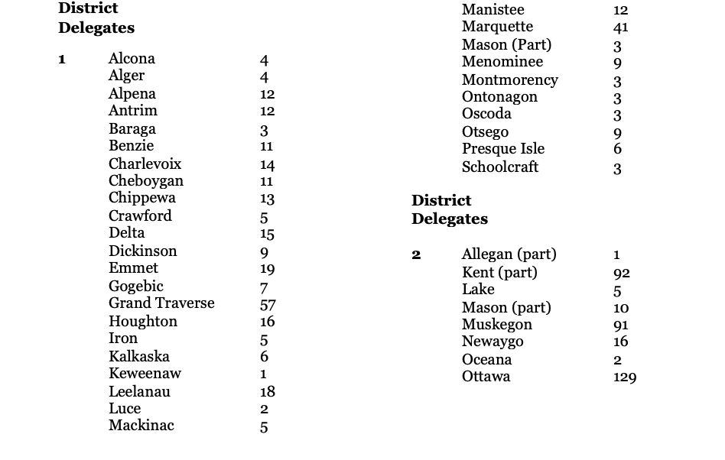
SADV

Slide 8
Weighted Voting
weighted voting: using the SADV, whereby each county’s (or portion thereof) delegates within a multi-county Congressional District Convention, caucus, or meeting, or at the State Convention, have a voting strength proportional to the number of Democratic voters from that county (or portion) at the last General Election relative to the total number of Democratic voters in the District or the state, regardless of how many delegates are present at the convention, caucus, or meeting. Currently applies to all districts except the 13th.
The SADV is divided by the number of people in attendance from each area to determine the value of an individual convention vote. In order to offer the party’s endorsement to candidates or approve most convention business, a majority of delegate votes must be cast in favor.

Slide 9
Weighted Voting - Continued
Weighted voting must be used in all elections and other votes held at the MDP Convention, and in Congressional District Conventions, caucuses, or meetings where the Congressional District is made up of more than one county (currently, Districts 1-12 and 14). The purpose of weighted voting is to make the voting strength of each county’s (or portion thereof within a Congressional District) delegation at the assembly reflect the Democratic voting strength of that county (or portion), regardless of how many delegates are present from each county.

Slide 10
Quick Note - This isn’t as hard as it looks!
A note on procedure: The Michigan Democratic Party Provides a an excel tabulator every two years to units.
This makes sure tabulation is done correctly/smoothly

Slide 11
Single Position Offices
Single position offices
an office filled by only one person. Examples are Chair, Treasurer, etc.,
A majority of the weighted delegate vote shall be required to win a single position office such as Chair, Vice Chair, Treasurer or Secretary.
Can be elected one by one or as a group (slate)
If no candidate receives a majority (over 50.0%) of the votes, the candidate with the lowest vote total, or candidates tied for the lowest vote total is (are) removed, and the election repeated, until a majority for one candidate is achieved.
The rules adopted for a given Convention or meeting must specify either that the single-position offices (i.e., officers) to be elected at the Convention or meeting must be elected separately, or alternatively must be elected as a group, with each slate contesting the election including candidates for one or more of the offices to be elected. However, in the latter case the election will not be resolved according to proportional representation rules, but as winner-take-all, with the slate achieving a majority electing all its candidates to office. If the slate achieving a majority does not include candidates for all offices to be elected, then all candidates on that slate are declared elected, and the election for unfilled offices proceeds as specified above.

Slide 12
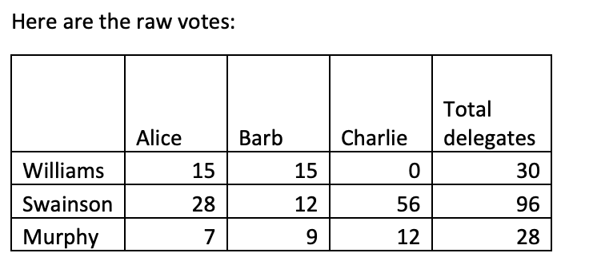
Example - Majority Election
A1: Example of Majority Election with Run-off Candidates Alice, Barb, and Charlie are running for District Chair in a District made up of three counties, Williams County having an SADV of 60, Swainson County having an SADV of 48, and Murphy County having an SADV of 12.
STEP 1: The candidates’ names are read aloud, and each county caucuses separately, tallies their votes for each candidate, and reports the raw numbers of votes to the convention or caucus secretary.

Slide 13
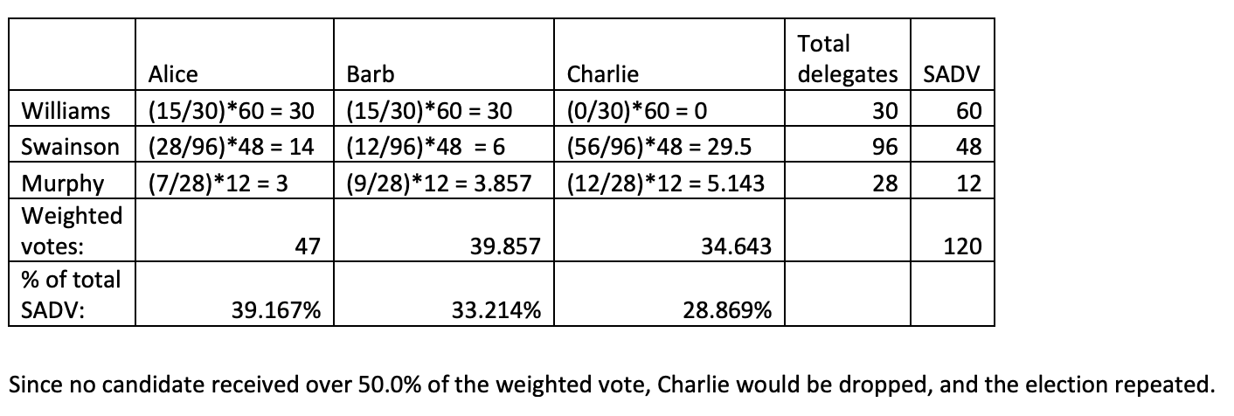
Example - Majority Election
STEP 2: The Secretary calculates the number of weighted votes received by each candidate, according to the SADV process (4.0), by dividing the raw number of votes for a candidate within a county by the number of voting delegates from that county, then multiplying by that county’s SADV. Weighted votes for each candidate from all counties are then added, and the sums divided by the total District SADV to give the percentage of District SADV achieved by each candidate:

Slide 14
Multiple Position Offices
Multiple position offices
an office for which more than one person is to be elected. Examples are County or District Executive Committee members, delegates or alternates to the State Central Committee, delegates or alternates to the Democratic National Convention, and Democratic National Committee members.
A body could use either slate voting or geographical distribution to elect members to multiple position offices.
slate voting: a voting method for electing multiple-position offices in which delegates vote for a group of candidates appearing on one slate (list) out of several, where the order of the candidates on the slate is predetermined.
A slate may consist of one person up to the number of positions to be elected.
The candidates elected are determined by the order in which their names are listed on the slate beginning with the top and moving down until the total number of positions to which the slate is entitled has been filled.
proportional representation: using an approved election method for multiple-position offices such that a substantial minority within the assembly has an opportunity to elect a proportionate share of the delegates or members. For example, 20% of an assembly would have the opportunity to elect one out of five delegate positions.

Slide 15
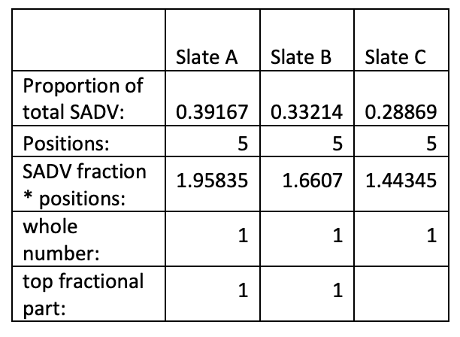
Slate Voting
Math is identical to single position office up to the part where the proportion of SADV is calculated. The proportion each slate received is multiplied by the number of positions to be elected. The whole number portion of each result is the number of persons elected from that slate. If there are any unfilled positions, the largest fractional portion of the above results shall receive the first unfilled position, the second largest fractional portion shall receive the second position, and so on.

Slide 16
Geographical Distribution System
A system of geographical distribution may be adopted. Under this system, the positions to be elected are allocated to pre-existing political or election subdivisions (e.g. Counties within a Congressional District). This must be done on a weighted basis; that is, according to the SADV of each area: Positions allocated to a subdivision = (SADV of the subdivision / total SADV) * total number of positions to be allocated.
The whole number portion of the results are the number of positions allocated to that subdivision. If there are any unfilled positions, the largest fractional portion of the above results shall receive the first unfilled position, the second largest fractional portion shall receive the second position, and so on.
If a geographic system is adopted, the election for delegates in each category (male or female, delegate or alternate) allocated to each county could be carried out at the district level, or each county could elect its own delegates, as specified in the district rules for that convention, caucus or meeting. Slate voting would be used for each county allocation in each category, unless any of the allocations were for a single winner, in which case majority voting would be used.

Slide 17
Geographical Distribution System
A3: Example of Geographical Distribution System In the example used above, if the nine (five women, four men) State Central delegates were allocated among the counties of the district, the allocation would be:
From the whole-number parts, four allocated to Williams County, three to Swainson County, and none to Murphy County; two are left unallocated; first goes to largest unused fractional part 0.9 (Murphy County), second goes to next largest unused fractional part 0.6 (Swainson County). Total delegates are four from Williams, four from Swainson, one from Murphy.

Slide 18
Weighted Voting vs. Proportional Representation
There are two separate concepts fundamental to elections in the Michigan Democratic Party which must not be confused:
How do we make sure that the voting strength of delegates from each county (at a district caucus or the state convention) reflects the relative number of Democratic voters from that county at the last General Election? This is weighted voting, using the State Allocation of Delegate Vote (SADV) process.
How do we make sure that a substantial minority within the assembly has the opportunity to elect their choice for a proportionate share of the positions being elected? This is proportional representation, as defined above, using an approved voting method for electing multiple-position offices (such as for State Central delegates and alternates, county or Congressional District Executive Committee members, Democratic National Committee members, or delegates and alternates to the Democratic National Convention).

Slide 19
Questions?

