Slide 1
Rapid Responsive Communications Strategy
&
The American Rescue Plan

Slide 2
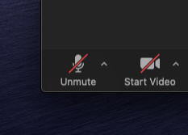
Zoom
Please be muted unless you have a question or comment

Slide 3
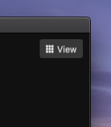
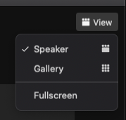
Zoom
Click “Speaker View” so that you can see my screen

Slide 4
Communications-based
Rapid Response

Slide 5
Deciding When to Act
Do we have a stake in the issue?
Will our supporters see us as a leader on this issue?
Is this conversation relevant to the people that we’re hoping to mobilize?
Does this dignify a response?
Is the candidate’s (or party’s) reputation at risk?
Is this an opportunity to strengthen our narrative?
What influencers can we leverage to amplify our message?

Slide 6
Basic Prep
Have someone (or a committee) responsible for monitoring social media, traditional media, and events (when it is safe).
Develop an approval protocol for rapid response. Decide what types of responses need approval from which people before being released.
Create a resource to draw from - you can build this organically over time
Cultivate relationships with local press - get to know the reporters

Slide 7
The Response
The tone of your response may vary by platform. You might clapback with a sharp reply on Twitter while also sending an email to the candidate or elected official that thoughtfully addresses the issue at hand.
Speak to the heart of the matter. When you are under attack or attacking an opponent, it can be tempting to address every single point like you’re in a debate class. Instead find a key vulnerability and focus your attention there. You can educate your audience as you disarm your opposition.
If you catch someone in a lie, call it out for what it is. Respond calmly and back the truth up with sources.

Slide 8
Structuring the Response
Define the issue - what is at stake?
Why is the bad for Michiganders, Americans, etc…
Contrast with the alternative

Slide 9
Example of a Response
Michigan Democratic Party Statement on SCOTUS Hearings
The Michigan Democratic Party released the following statement on behalf of Chair Lavora Barnes on the SCOTUS confirmation hearings that began today:
“Today’s Supreme Court hearings make very clear that health care is at stake in this election. Trump and Republicans like John James have relentlessly attacked the Affordable Care Act and protections for people with pre-existing conditions, and are now trying to confirm another far-right jurist that would support their efforts to gut the law in the middle of a pandemic. Michiganders deserve leaders who will fight for access to affordable health care, and that’s why we will vote early, by mail, and on November 3 for Joe Biden, Kamala Harris, Gary Peters, and Democrats up and down the ticket.”

Slide 10
Rapid Response Tools
Statement to local media
Video/Print/Radio
Email to supporters
Phone calls to supporters
Call to action to supporters
Website
Social Media!

Slide 11
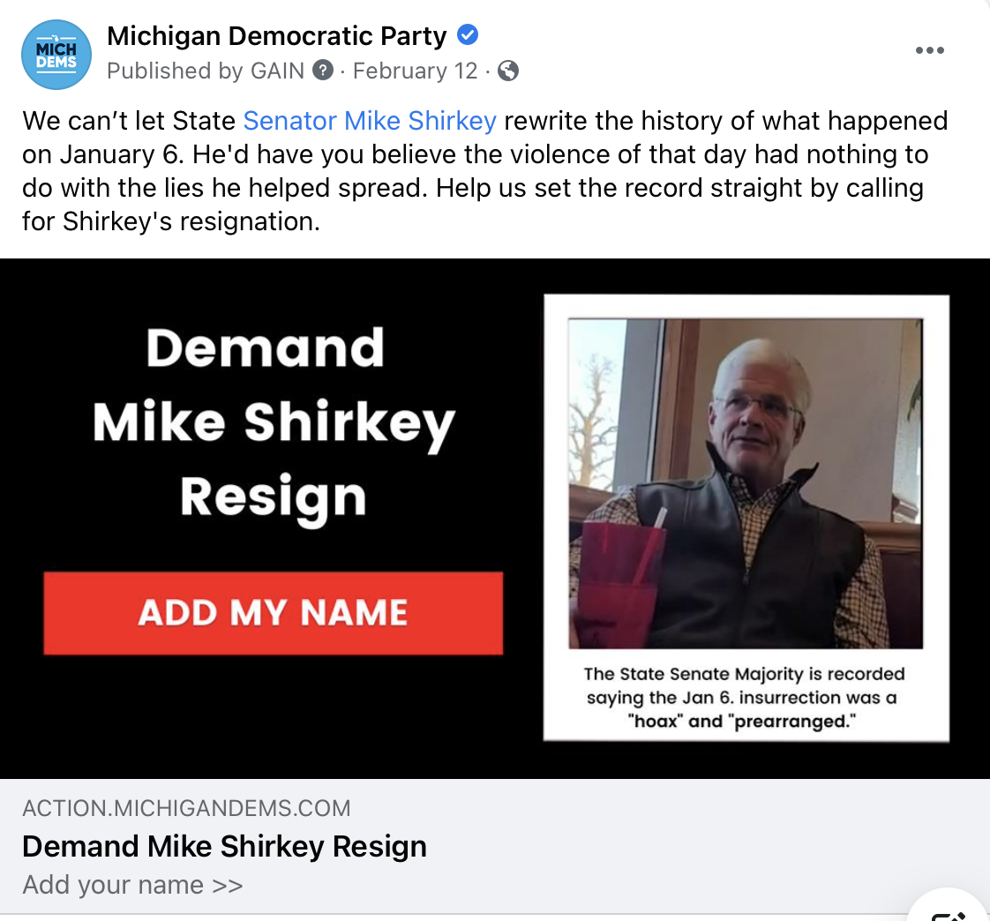
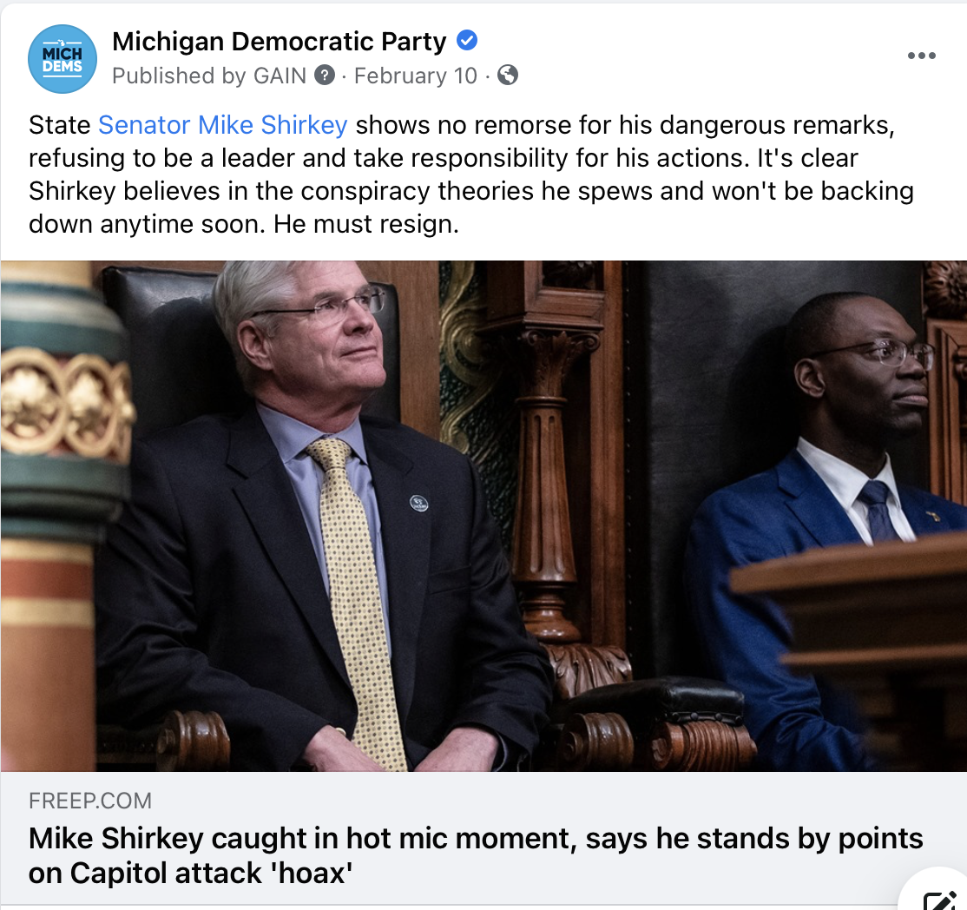
Examples of Rapid Response

Slide 12
Examples of Rapid Response (web based)
GOP Hall of Shame: Sedition Edition
John James Revealed
Shady Shirkey

Slide 13
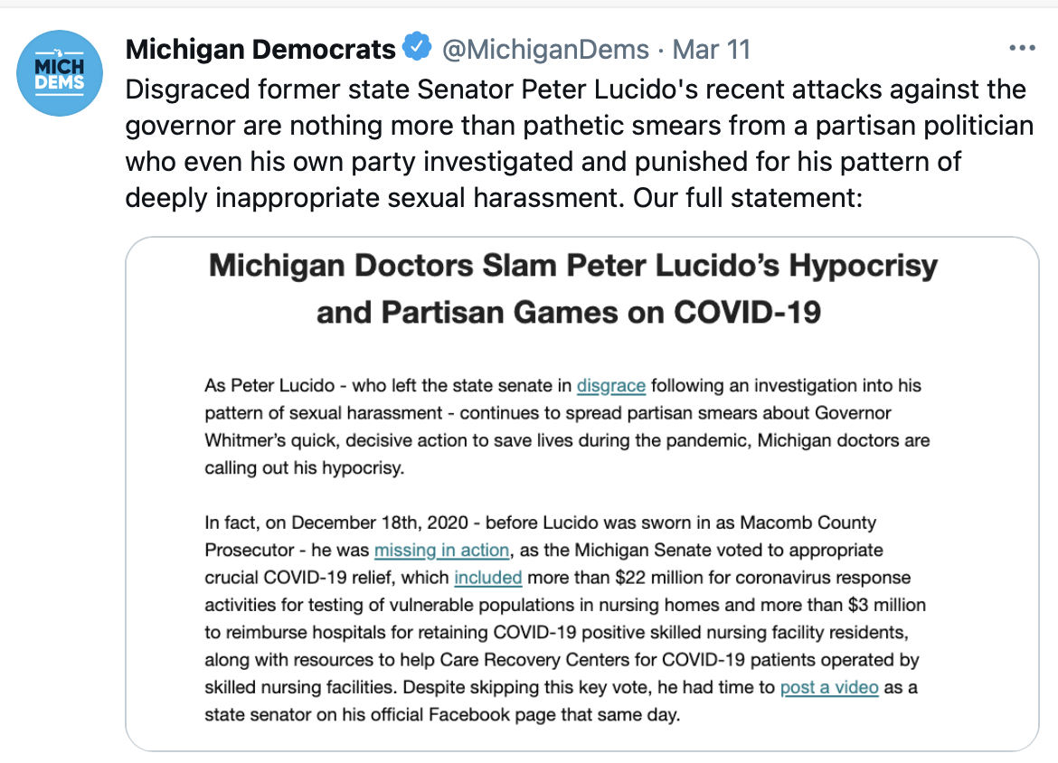
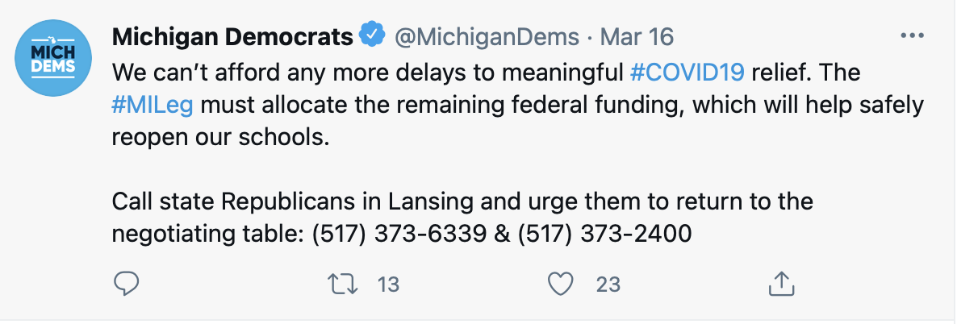

Slide 14
The Debrief
Rapid response never really stops. There will always be another comment, ad, or tweet-storm to react to but it is important to take a breath and assess your work.
What went well? Did we reclaim the narrative?
What went poorly? Did any part of our response backfire?
How can we improve our response next time?
Notes:
You don’t always need to be “rapid” in your response - but sometimes just offering a response in a somewhat timely manner is enough, especially if this is a story that is likely to stay alive in the media or on social media for a prolonged period of time.

Slide 15
How to Talk About the American Rescue Plan

Slide 16
Let’s Be Clear: This. Is. Urgent.
Just 50 days after taking office, President Biden signed a bold and historic package that will provide desperately needed relief to millions of working Americans
But the work isn’t done. We need to make sure voters know Democrats delivered for them when it mattered most
Every single Republican voted against the American Rescue Plan, and we need to make sure they are held accountable for that vote
To win elections in 2021, 2022 and beyond, we need trusted voices like yours to spread the word now about this incredible victory and what it means for people across the country
The time to act is NOW

Slide 17
Topline: Help is Here
When President Biden took office, he promised the American people that help was on the way. Now, Biden and Democrats have delivered on that promise.
Help is here. Biden and Democrats have delivered real, tangible results for the American people and their families, beginning with direct payments of $1,400 to working people and resources to help manufacture and distribute vaccines.
DIRECT PAYMENTS: This plan will get checks out the door, starting this month. Over 85% of American households will get direct payments of one thousand four hundred dollars per person.
VACCINES: This plan provides funding for vaccine distribution, coronavirus testing, and contact tracing so we can get vaccines into the arms of more people.
Key Point: The American Rescue Plan is the most consequential piece of legislation for working families in modern American history

Slide 18
What Republicans Opposed
The American Rescue plan is bipartisan. Democrats voted for a package that enjoys broad support from Democrats, Republicans, and independents across the country. Yet, not a single Republican in Congress supported it.
Democrats voted to send $1,400 checks to Americans bearing the brunt of the crisis – not a single Republican in Congress joined them.
Democrats voted for a national vaccination program to get shots into people’s arms – not a single Republican in Congress joined them.
Democrats voted for aid for small businesses struggling to keep their doors open – not a single Republican in Congress joined them.
Democrats voted for funding to keep educators on the payroll, safely reopen schools, and lower health care costs for millions– not a single Republican in Congress joined them.

Slide 19
Be LOUD, Be PROUD
It's hard to exaggerate how important and sweeping the ARP is - so DON'T BE BASHFUL
The ARP is the most sweeping piece of legislation for families, workers, and public health in modern history - SAY IT WITH FEELING!

Slide 20
The Bottom Line for Families
The provisions in this bill are going to help the bottom lines of millions of families:
Direct Checks of $1,400
Extended Unemployment Insurance
Expansion of the Child Tax Credit
Small Business Relief
Lower Health Care Premiums and COBRA Assistance

Slide 21
Ways to Take Action
Contact Your Elected Officials
THANK Democrats
CRITICIZE Republicans
Share Your Story
We’ll be amplifying stories from Americans across the country who have been impacted by the pandemic and will benefit from the American Rescue Plan.
If you, or someone you know, has a story you would like to share, send us the video HERE.
Write an Op-Ed
An opinion piece is also a great opportunity to praise your member of Congress for supporting it, or criticizing them for opposing it.
Highlight key details and what they mean for you

Slide 22
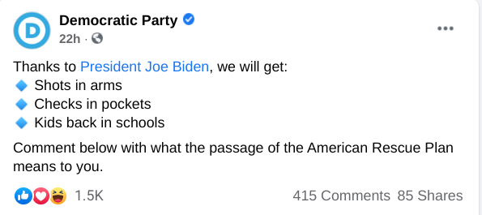
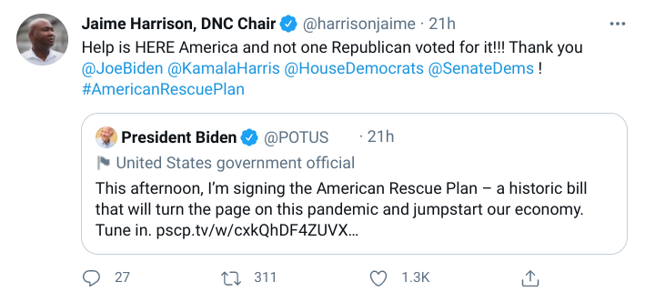
Twitter, Facebook, and Instagram
Use the talking points we went over today to promote the American Rescue Plan to your networks!
We especially need folks to post in any Facebook groups you’re a part of
And be sure to follow and retweet @JoeBiden, @POTUS, @VP, @KamalaHarris, @harrisonjaime, @WhiteHouse, @TheDemocrats, and @DNCWarRoom for content amplifying the American Rescue Plan

Slide 23
Abby Rubley
arubley@michigandems.com
517.420.6777

Slide 24
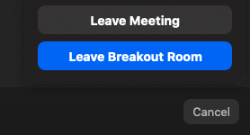
Zoom
Return to main room before next set of breakout sessions

