Slide 2
Party Structure
Hayley Alderman, Director of Party Affairs

Slide 3
Overview
Party’s Purpose. What is a party? What do they do?
Party Structure. How is it structured? What do leaders do?
Party Meetings & Conventions. What purpose do they serve? How do we prepare?
Party Rules. What are the basics? What is Roberts?

Slide 4
What is a party?
A political organization which seeks to build collective power to influence policy making and outcomes through the election of those who share similar values.
Parties can be organized around an individual, specific policies, an ideology or philosophy or, as in the case in the United States, built around broad based coalitions.

Slide 5
What do parties do?
Nominate candidates for public office. This can be done by appointment, party convention, or through a primary.
Fight to elect candidates who carry their banner to public office.
Increase the bargaining power to elected officials, giving them more influence and ability to advance an agenda.
Regularly adopt a platform, a document which lays out what a party will prioritize and fight for.
Represent party members to their elected officials.

Slide 6
Party Organizations
Statewide Caucuses: responsible for representing the diverse interests of the party’s many constituencies.
Congressional District Party: responsible for electing Democrats to Congress.
County Party: responsible for electing Democrats to county offices and state offices within the county.
Local Club: responsible for electing Democrats to municipal offices.

Slide 7
Party Responsibilities
Developing an organizational plan. Includes goals, timelines, and metrics.
(County) Apportion Precinct Delegates based on last election. April of even years.
(County) Appoint County Board of Canvassers. Gives three names of potential canvassers by September of odd years.
(County) Replaces nominees if vacated after primary.
(County) Involved in redistricting county commission seats
Organize meetings and conventions.

Slide 8
Party Leadership Defined
MDSCC: Highest decision making body in the State Party. Shares this distinction with State Conventions one day a year.
Executive Committee: Deals with questions of policy & administration in between regular meetings of the DSCC. Locally, exists to elect statutory officers and deal with questions of policy & administration in between meetings of the County or District Committee.
County or District Committee: Highest decision making authority in local organization. Composed of members of the EC, Statutory Officers, and members.
Chair: Highest officer in a party organization. As the head, serves as the public face, spokesperson, and representative of the party. Charged with running meetings & elections, day to day administration of the Party.
Vice Chair: Carries out the duties of the chair in their absence. Vice Chairs do not automatically become the chair in case of vacancy.

Slide 9
Party Leadership Defined (continued)
Treasurer: Chief financial officer of a party. Charged with implementing smooth & efficient donation processing procedures, maintaining accurate records of each donor, donation, and expenditure, and filing timely reports to state and federal authorities.
Secretary: Charged with the creation, maintenance, and submission of party records (meeting minutes, roster of officers & party leaders).
Precinct Delegate: The most localized representatives of the Democratic Party. Serve as campaign leaders in their precinct. Recruits new members, builds and maintains relationships with citizens in their precinct.
Committees: Committees are groups appointed for a specific purpose. They exist to make conducting business for larger groups more manageable and deliberate. Can be standing, convention, or ad hoc.

Slide 10
Party Resources
Party Affairs
Membership
Fundraising
Communications
Digital Organizing
Voter Protection
Compliance
Data - VAN
Training

Slide 11
Project 83
Established in 2017
Permanent organizers
Split up turfs by county (State Map)
Tasked with assisting local parties/volunteers/candidates in their efforts, and reinvesting at the grassroots level

Slide 12
One Campaign
One a cycle-by-cycle basis
A separate wing of the party, but all in the same MDP family
Organizers
Focused on recruiting precinct delegates in 2019
Offices
Ramping up

Slide 13
Questions?

Slide 14
Conventions and Meetings: Who can participate?
Precinct Delegates and Democratic nominees to partisan office.
Individuals who have been members of the Michigan Democratic Party for at least 30 days prior to the convention or meeting. To vote or hold ANY party office, one must be a member of the Michigan Democratic Party.
The same requirements exist for holding Party office and voting.

Slide 15
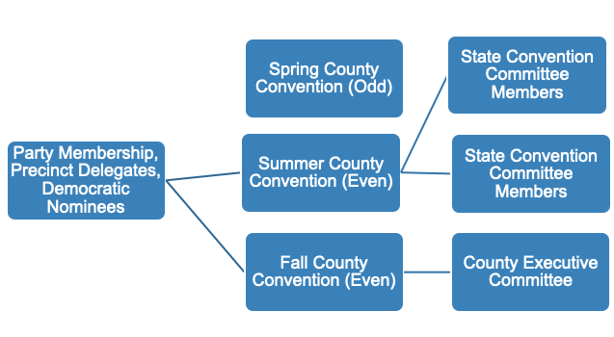
Local Conventions

Slide 16
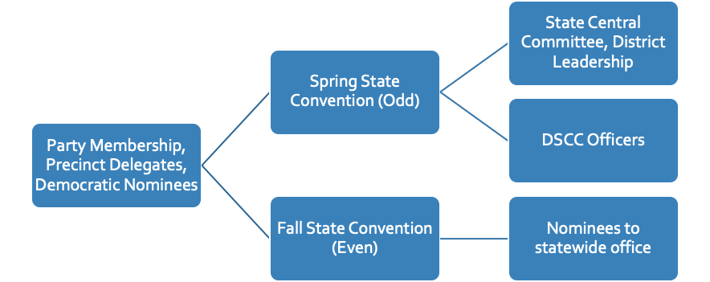
State Conventions
Endorsement
conventions (sometimes)

Slide 17
Types of Conventions
Nominating Convention: Fall in even numbered years, places statewide candidates (except those elected by primary).
Endorsement Convention: Spring in even numbered years, offers the party endorsement to certain statewide candidates.
Party Leadership Convention:
Statewide- Spring in odd numbered years, party members select leadership for two years.
County- Fall in even numbered years, members select Executive Committee members who go on to elect officers for two years.

Slide 18
State Convention Process
Michigan Election Law lays out the timing and purpose for most conventions. Party rules largely mirror these provisions in law.
The State Central Committee calls the convention and mandates rules and processes. This must be done more than 60 days before the convention is to be held.
County and District Parties hold conventions to elect Convention Committee Members, consider resolutions, or elect leadership.
Convention Committees (Resolutions, Rules) meet discuss the business for convention.
On the day of convention, caucuses meet beforehand to discuss the business at hand.

Slide 19
Rules Defined
Bylaws: Guiding set of permanent rules established by a body which cannot be set aside or changed without prior notice.
Standing Rules: A set of rules that may be established by a body for the purposes of a single meeting. These may not conflict with an organization’s bylaws. A body may choose to amend or otherwise set aside these rules.
Rules of Order: Parliamentary procedure adopted for use in all meetings of a body. The MDP uses Robert’s Rules of Order.

Slide 20
Planning Conventions

Slide 21
MDP Bylaws
Every rule established by a local body must comply with the rules of the MDP. Any changes are subject to approval by the Secretary of the DSCC or their designee.
The use of secret ballots is prohibited at every level of the Democratic Party with few exceptions. Every vote must be publicly traceable to a member.
An appeals process exists to settle matters of procedural fairness and rules violations. They have jurisdiction over the entire state.
Proportional voting is used in the election of party leadership (Executive Committee, State Central, Delegates to Convention). Proportional voting ensures fairness in our elections by:
Allowing everyone to win a piece of the pie equal to their performance in the election.
Ensuring that smaller counties receive the full number of delegate votes they are entitled to.

Slide 22
Rules for Voting and Elections
In 2018, the party approved a line by line review of party rules. The result was the most significant restructuring in recent memory.
As part of this review, the rules for voting and elections were clarified. The new voting directive is available at michigandems.com.

Slide 23
Parliamentary Procedure: Robert’s Rules of Order
Rules that limit, guide and protect the individual
To facilitate the transaction of business
To promote cooperation and harmony
To ensure that all members have equal rights, privileges, and obligations
Ensure the majority has the right to decide, but the minority has rights which must be protected as well
It’s not that the decision you make must be correct, but each decision you make must be correctly made.

Slide 24
Questions?

