Slide 1
DIGITAL FUNDRAISING AND TOOLS WEBINAR
Kathleen Todd, Digital Director
ktodd@michigandems.com

Slide 2
Introductions
In the chat, please introduce yourself:
Name
County and Role (e.g. Chiar, Vice Chair, Treasurer, etc.)

Slide 3
Webinar Agenda
Welcome and Housekeeping Announcements
Fundamentals of Digital Fundraising
All About Emails
ActBlue Best Practices
Social Media Fundraising
Texting and Ads Fundraising
Questions

Slide 4
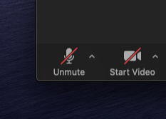
Zoom
Please be muted unless you have a question or comment

Slide 5
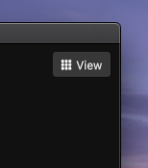
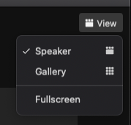
Zoom
Click “Speaker View” so that you can see my screen

Slide 6
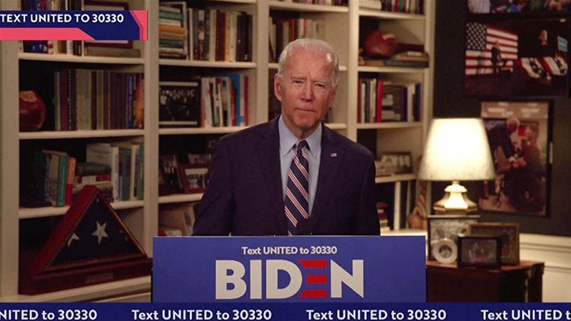
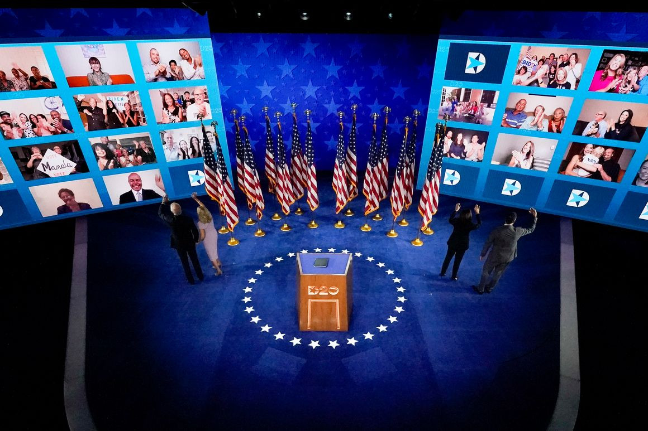
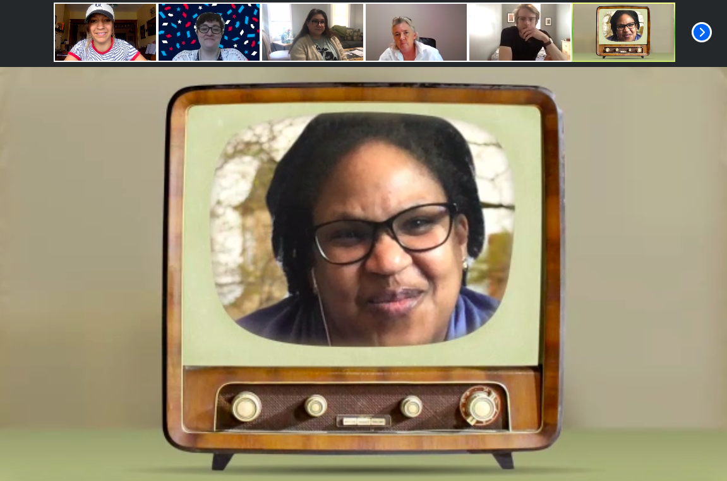
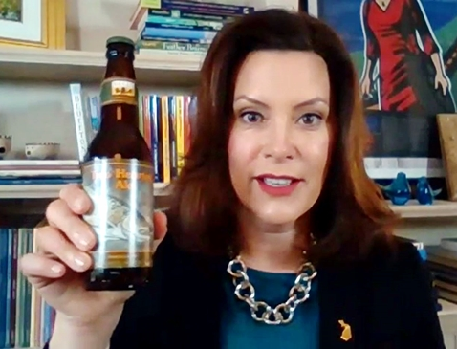
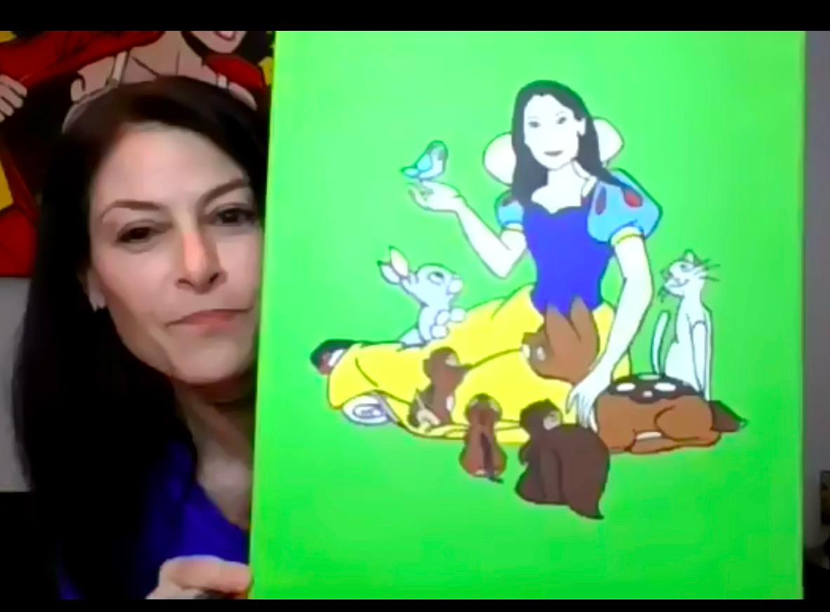
The 2020 Virtual Election
Notes:
As crowded and competitive as they can be, email inboxes remain a prime location for nonprofits to scale communication and engage with thousands of supporters with just a few clicks.

Slide 7
Building Your Email List
Collect emails everywhere
Make sure your website has a clear sign-up form that syncs to your CRM
Organic acquisition from social media. Ask followers to sign birthday cards, take surveys, or add their name to petitions
Be careful of list swaps or emailing inactive supporters who haven’t opened your emails in a while

Slide 8
Email CRMs
NGP 8 EveryAction
Action Network
MailChimp
Rates vary depending on projected overall capacity.
FREE - Less than 10,000 emails a month.
Plans vary from free to $199 per month.
Designed for larger email lists and more complex segmentation
Best CRM to sync with NGPVAN (same company)
It can be expensive when scaled
Free for small orgs, and ramps based on the quantity of emails sent
It can be manually synced with NGPVAN
Not great for vol management - you can only mark sign-ups not completions
While MailChimp’s functionality is impressive, they do have sending limits and it requires a lot of set up to get an email out.
It also doesn’t synch up with NGPVAN.

Slide 9
Types of Emails
Notes:
The welcome email serves as an introduction to the party for every new subscriber. Supporters expect to receive it when subscribing to an email list. Follow us on social >> survey >> donate
The thank-you email makes supporters feel truly valued, strengthens their connection to the party, and gives you an opportunity to highlight more ways for them to show their support.
The sustainer push email takes your email program further by asking recent one-time donors to become members of the party who give monthly and have voting privileges at state conventions.
The volunteer recruitment email is a way for your supporters to help elect Democrats beyond financial transactions.
The newsletter email is a regularly occurring snapshot of information about party operations, key highlights, and opportunities for supporters to take action.
The advocacy email uses digital advocacy forms to prompt calls, emails, or tweets to legislators to in support of your cause.
GOTV emails and event fundraiser emails.

Slide 10
Email Theory of Change
Problem
Solution
Call to Action
Thank You
- Set the stage for what’s at stake within the first sentence or two
- Examples: Deadlines, debates, endorsements, opposition, breaking news
- The reason why taking an action can make a difference in something your supporters care about.
-Highlight the difference this action can make toward your goals.
-Do X, so that Y, to achieve Z.
- Have one clear CTA
- Don’t just ask once! Repeat your CTA throughout the email
- Create a sense of urgency/deadline-driven language
- If you don’t ask for what you want, you won’t get it!
- Clear and concise
- Action verbs (RT, donate, commit, follow, etc.)
- Deadlines, create a sense of urgency
Notes:
A cause and effect sequence that begins with something the supporter can meaningfully do and ends with the resolution of the moment.

Slide 11
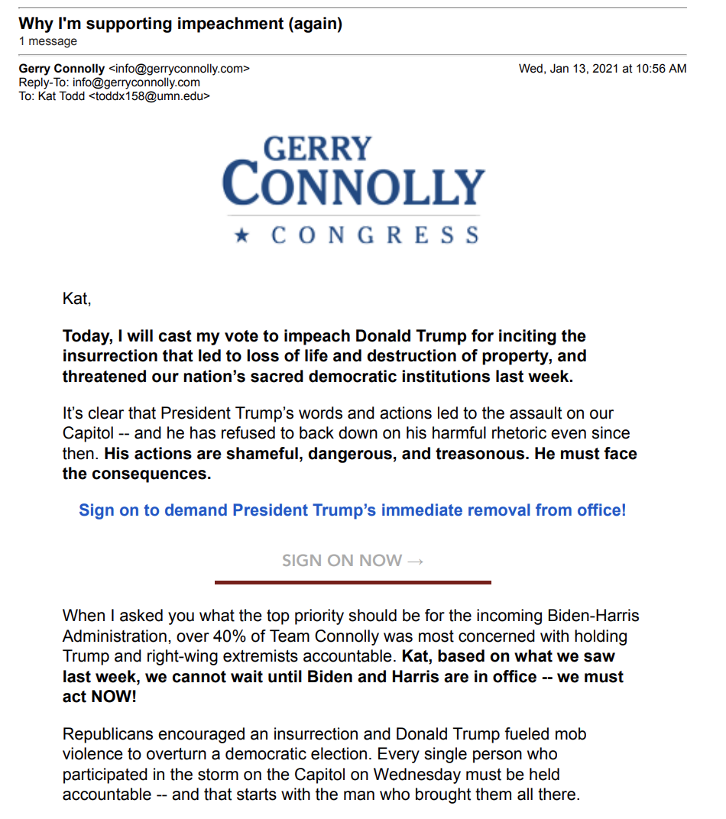
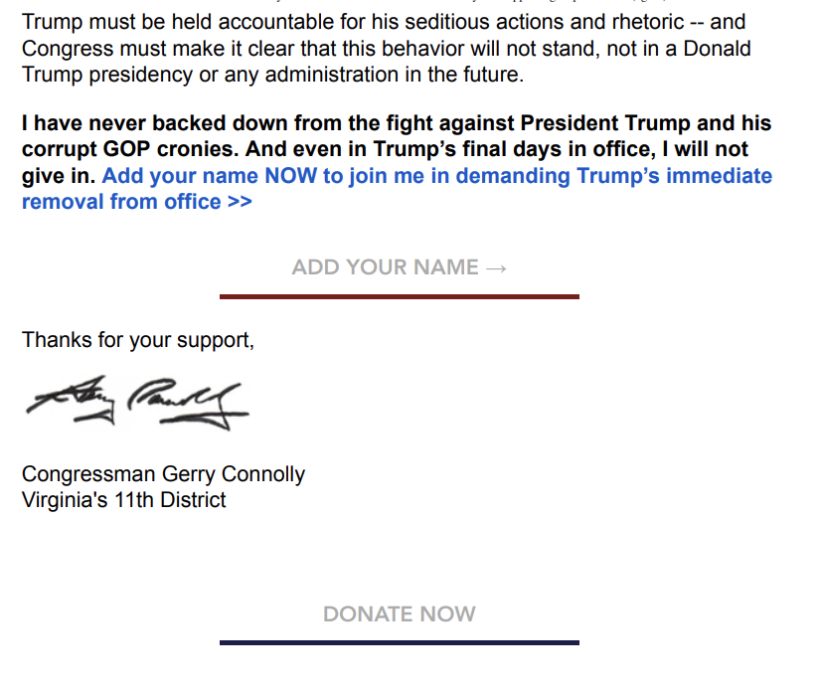
Good Emails vs. Bad Emails

Slide 12
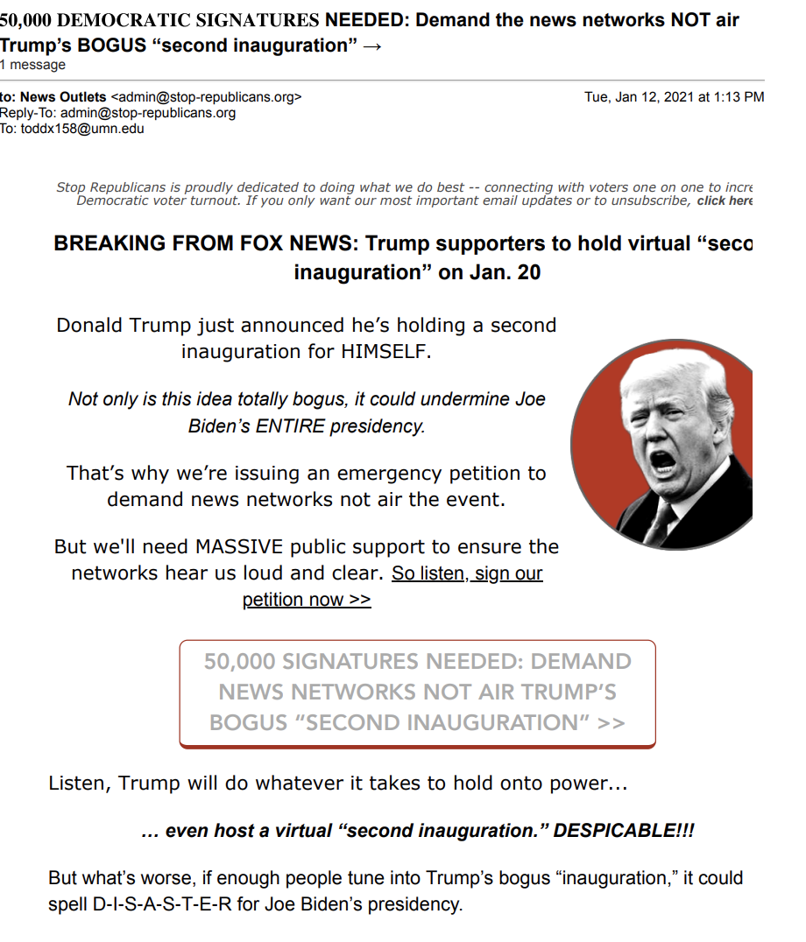
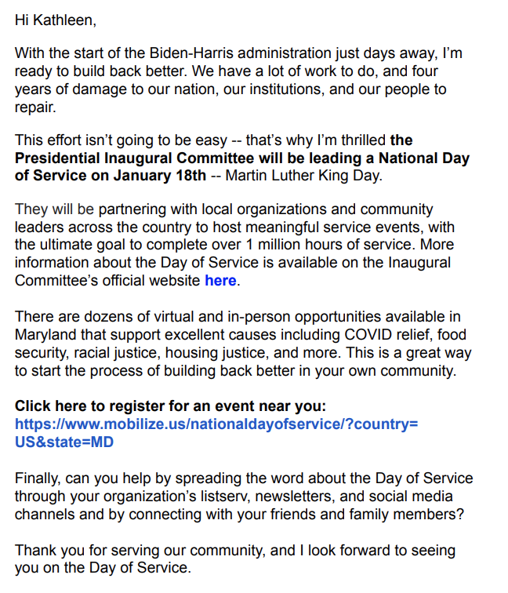
Good Emails vs. Bad Emails

Slide 13
ActBlue Best Practices
Branding + social share
Refcodes + analytics (e.g. ?refcode=)
Express lane + saved payment universe
Push people to join your email list so you can solicit them again

Slide 14
QUESTIONS?

Slide 15
Raising Money on Social Media
Use during big moments and for fundraisers/events
Always link to ActBlue
Create Facebook events for fundraisers
Push people to join your email list so you can solicit them again

Slide 16
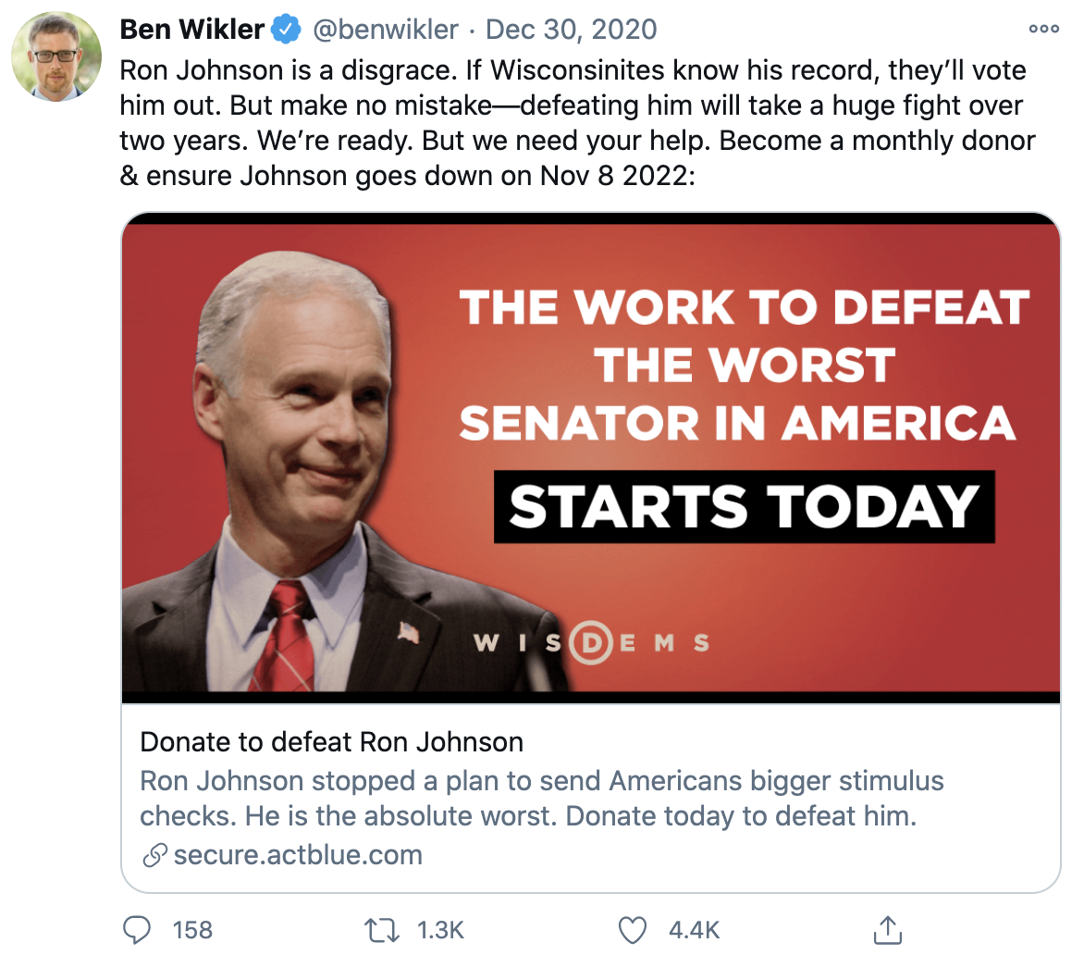
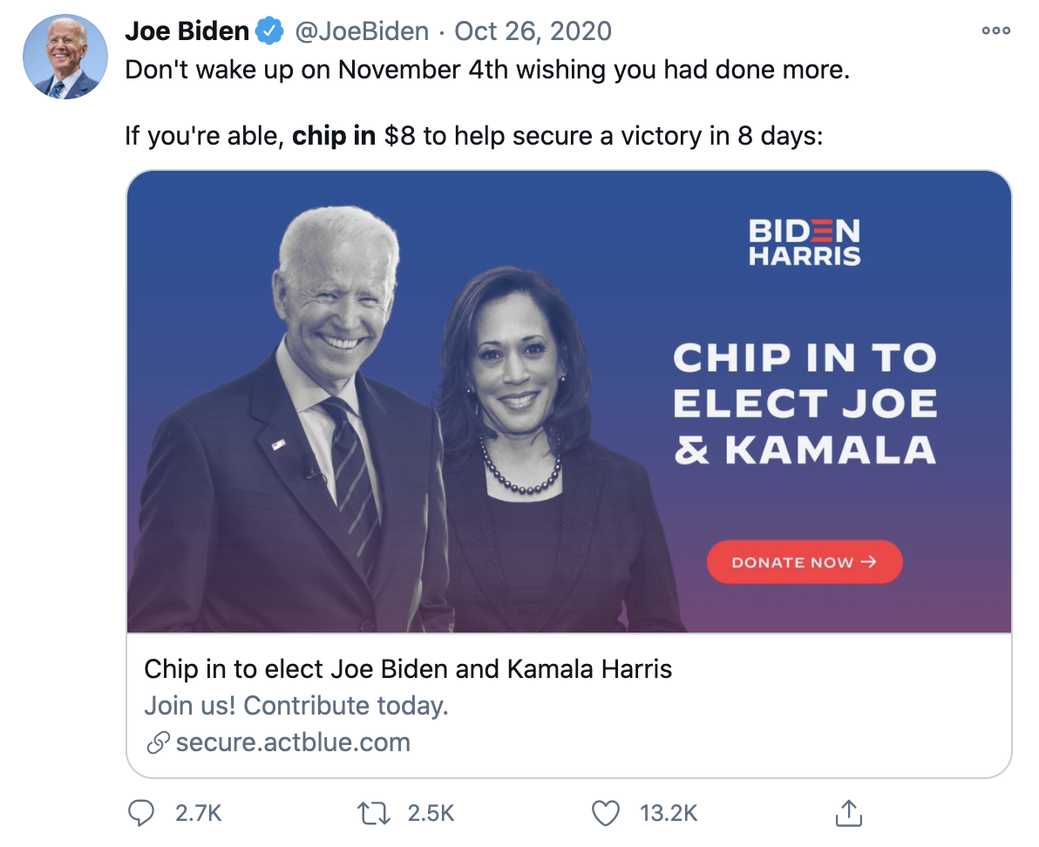
Raising Money on Social Media

Slide 17
QUESTIONS?

Slide 18
Raising Money by Texting
Similar to email, texting can be used as a great supplemental tactic to support other fundraising efforts
Make sure the CTA is clear and concise
The MDP does Peer to Peer (P2P) texting through TextOut, you don’t need prior opt-in, but it takes longer to run campaigns since one click = one text
While that means texting is often a less efficient fundraising tactic, texts have higher open rates than emails
Notes:
Types of texts include event recruitment, GOTV/voter contact, fundraising.
Helps cut through a crowded email inbox.
Best for following up with existing supporters/donors.
To build your texting program, require cellphones on sign-up forms and pull donor data from ActBlue.

Slide 19
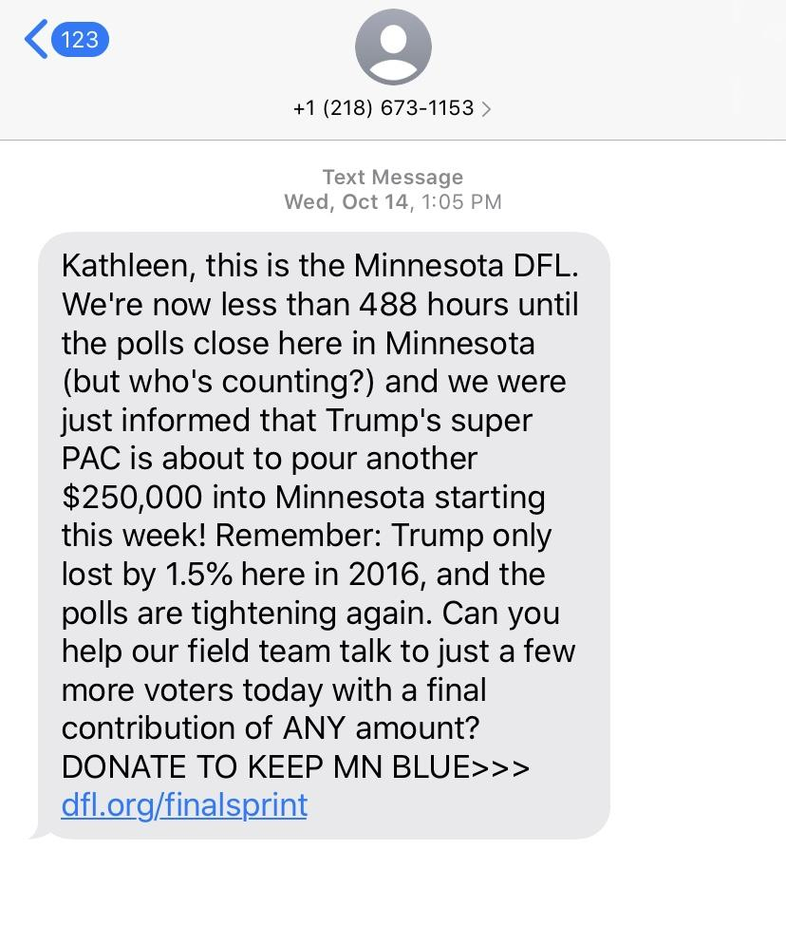
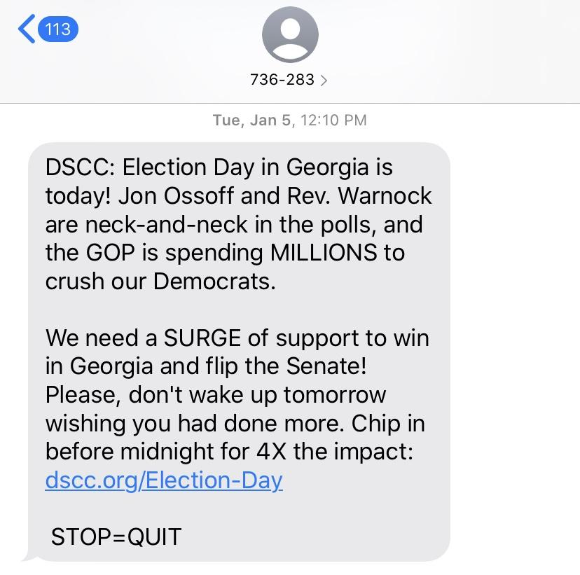
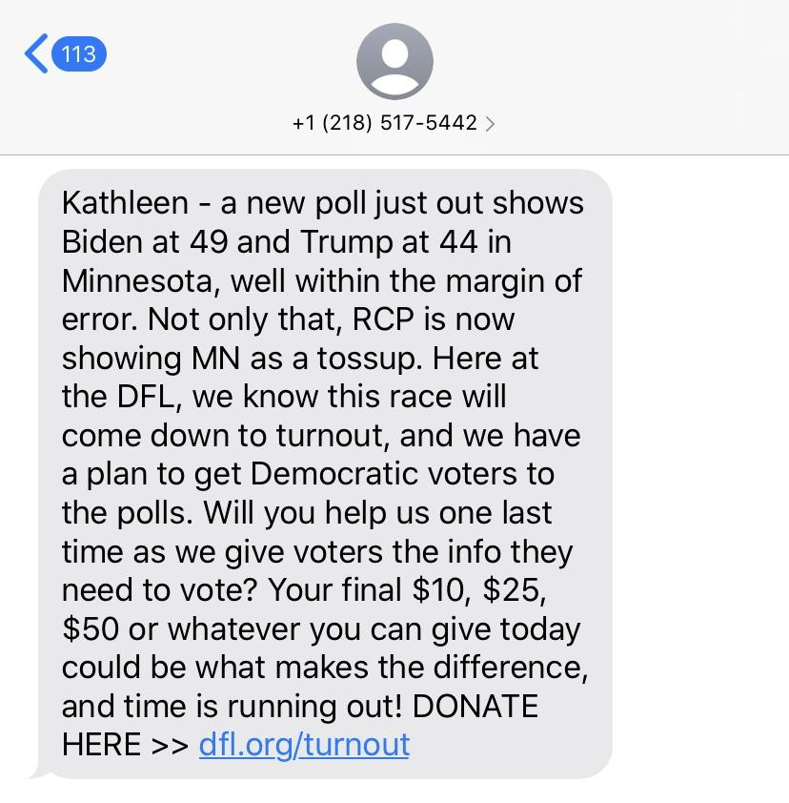
Raising Money by Texting

Slide 20
QUESTIONS?

Slide 21
Digital Advertising
Digital advertising can raise money directly or add new supporters to your list for future email fundraising
There are four types of ads: direct to donate, acquisition, persuasion, and mobilization
In order to run an ad you’ll need the following:
Creative (image/video + copy)
Audience (who you’d like to view your ad)
Budget (know how much you want to spend over a period of time)

Slide 22
Google Search Ads
There are three main components of Google Search ads:
Headlines (up to 30 characters)
Display URL (up to 15 characters)
Description (two lines, each with a 90 character limit)

Slide 23
Facebook Ads
In order to post political ads, you need to register and get approval from Facebook
It takes a while to get approved and you’ll need to upload a valid form of ID (driver’s license, passport, etc.)
You can upload data directly to Facebook and create “lookalike” audiences with your donor list

Slide 24
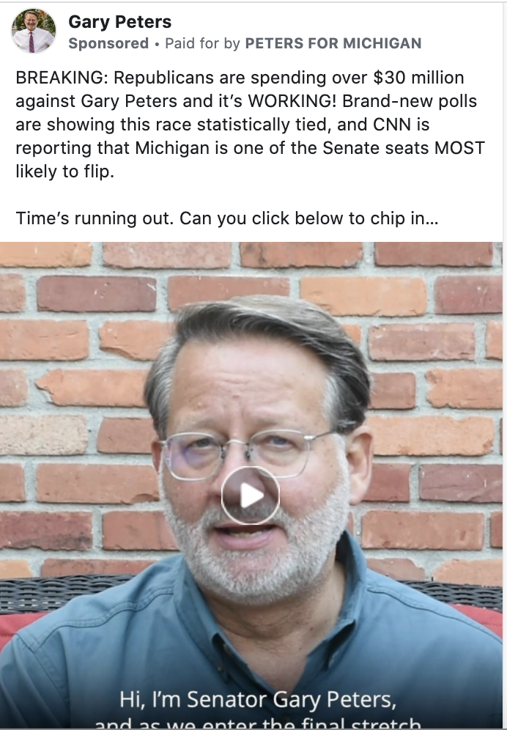
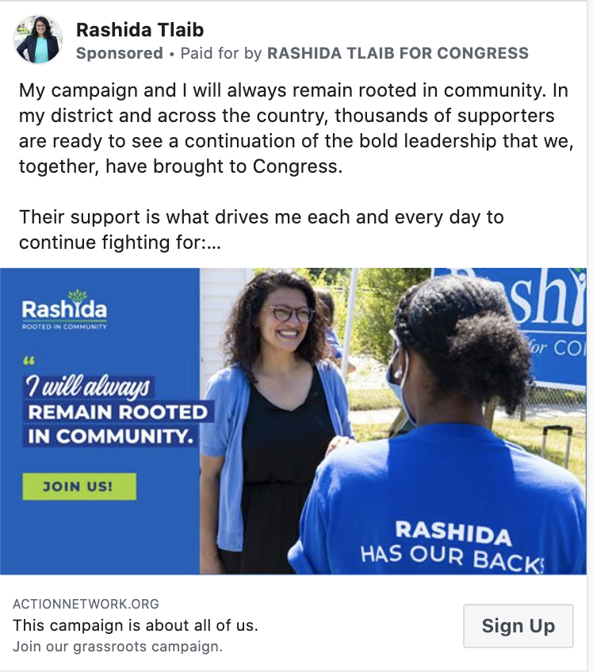
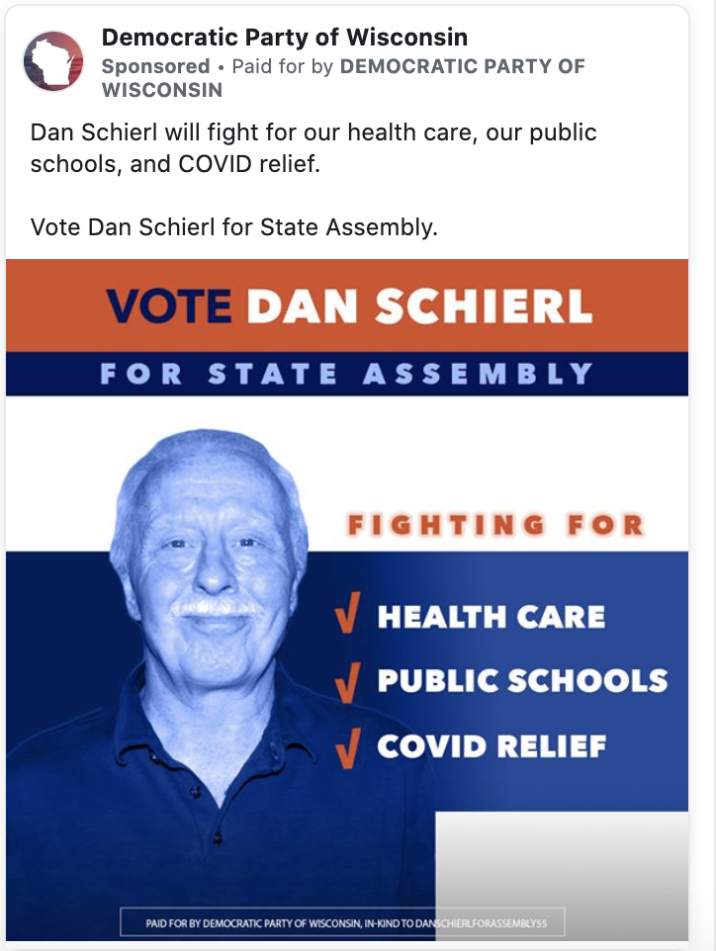
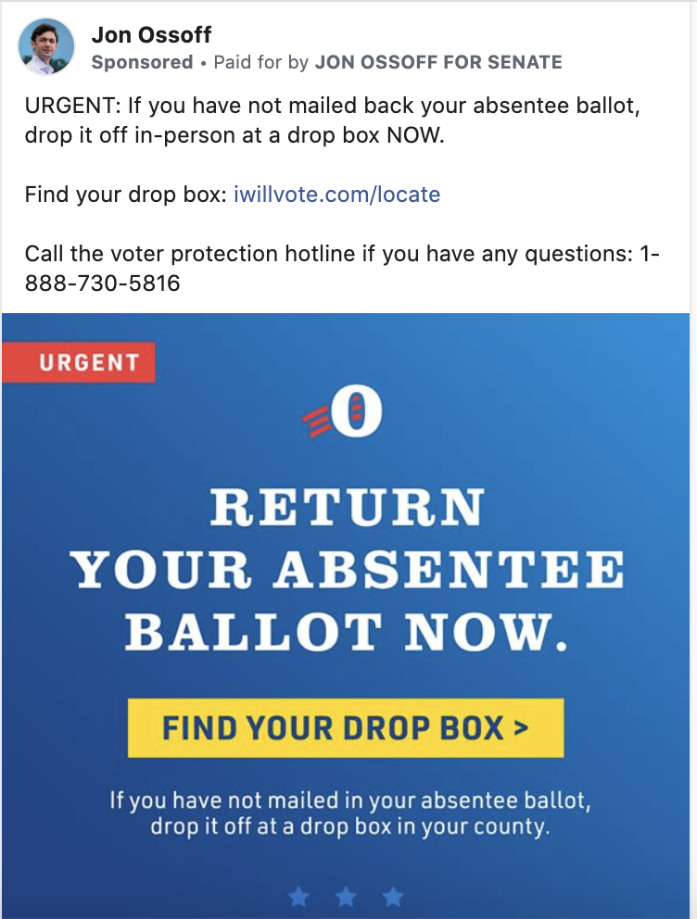
Facebook Ad Examples

Slide 25
QUESTIONS?

Slide 26
Mac users: Go to your app store & search for Slack
Windows users: slack.com/downloads/windows
Then click on the invite link: https://join.slack.com/t/michigandems/shared_invite/zt-gxc20d07-VxyuyTT6Bwgxs_bevIKxHg
Notes:
Invite link: https://join.slack.com/t/michigandems/shared_invite/zt-gxc20d07-VxyuyTT6Bwgxs_bevIKxHg

Slide 27
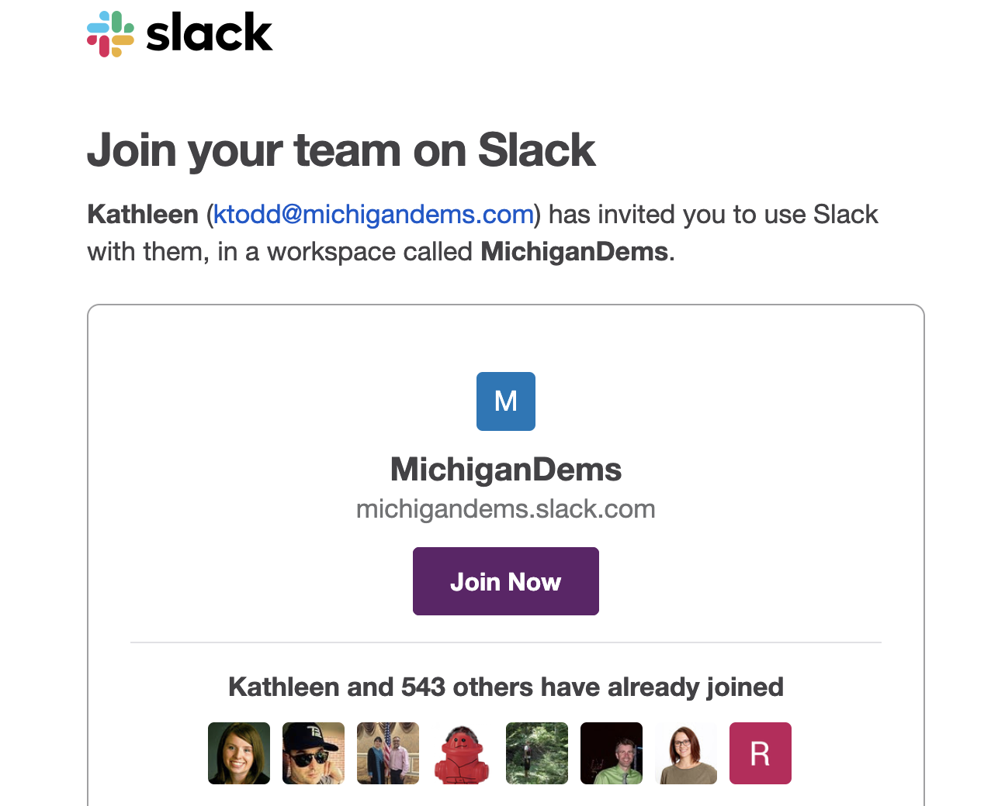
After you download Slack, click on the invite link: https://join.slack.com/t/michigandems/shared_invite/zt-gxc20d07-VxyuyTT6Bwgxs_bevIKxHg
Notes:
Invite link: https://join.slack.com/t/michigandems/shared_invite/zt-gxc20d07-VxyuyTT6Bwgxs_bevIKxHg

Slide 28
Final Notes
You can use social, ads, and texting for fundraising but email is going to be your primary digital tool
A content calendar is a must to track all of your online communications
You can search the Facebook Ad Library and Google Ads archive for inspiration

Slide 29
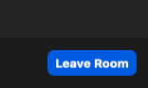
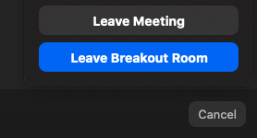
Zoom
Return to main room before next set of breakout sessions

