Slide 1
Bench Building & Candidate Recruiting
Notes:
Welcome to Bench Building and Candidate Recruitment training and Best Practices.

Slide 2
Overview
Doing the research- building the bench on a solid foundation.
Bench Recruitment- Identifying potential future candidates and working with them to build their public profile to help their eventual run for office.
Candidate recruitment- finding the right people to run for the right office
Candidate support- providing the resources to make our candidates successful.
Notes:
Candidate recruitment has two purposes. Obviously, recruiting candidates for every seat is the end goal. But first we need to do some research to identify the seats, terms of office, opposition, etc. From there we will work to start identifying potential candidates and start building the bench for future elections. Understanding this will help inform the recruiting process and will give additional options for when you have the recruiting conversation with prospective candidates. The best plan… is to create an actual plan to guide this process.

Slide 3
Bench Building 101
Notes:
Bench building – how does bench building differ from candidate recruiting? Bench building is basically your succession plan. It is recruiting early – preparing people to run for office in the future. Rather than scrambling to recruit and fill a particular seat when a vacancy occurs… you have a bench of potential candidates ready to run for office.

Slide 4
Do the Research Build a Recruiting Plan
Notes:
It all starts with data. From knowing about the individual seats to the underlying data of each precinct – the more that you know, the easier it is to identify potential candidates or to recruit someone for the offices in question.

Slide 5
Public Office Guide
Create a comprehensive document identifying each and every elected office in a given area, the length of term, when the office is elected, relevant filing deadlines, who currently holds the office, and who is running for the office. The guide is a living, breathing document which is regularly updated.
The information should be centralized and kept by either a county or district party.
The guide is then used to identify what seats are up for election at any given time, facilitating an easier candidate recruitment and bench building effort.
Notes:
#FunFact… it is not a plan unless it is written down and sharable with others.

Slide 6
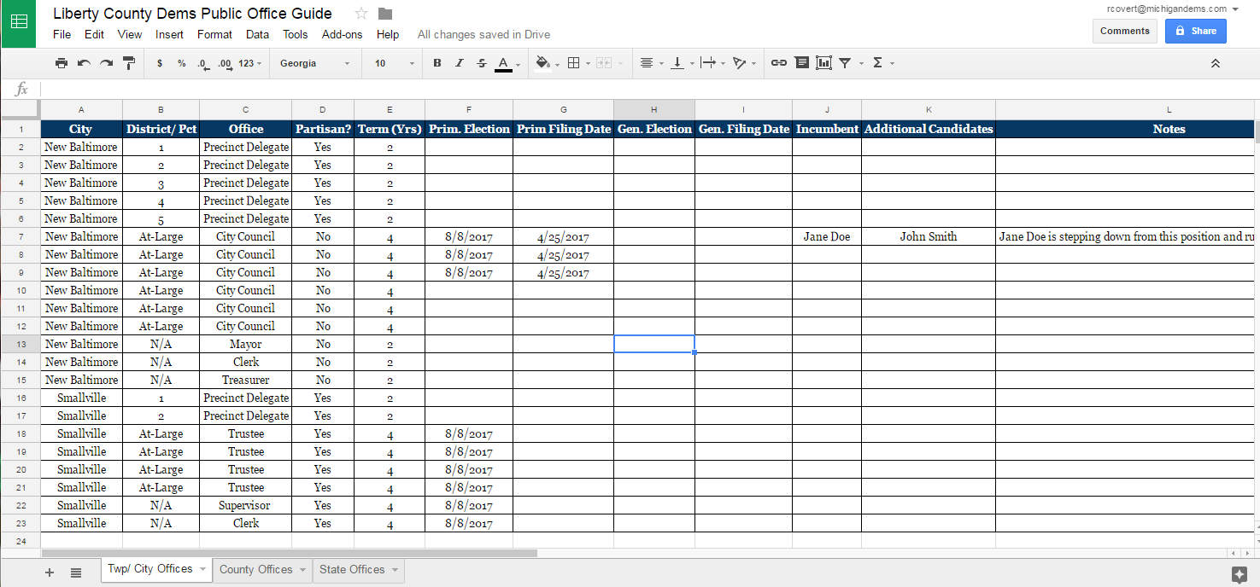
Notes:
The first part of your plan – you should create a complete inventory of every elected office (partisan and nonpartisan) in your county or district. Here is an example of a Public Office Guide. Make sure that your master document includes the office term, election dates, filing dates or requirements, etc. For instance, does the seat require a certain number of petition signatures? Can you simply pay a filing fee? Who currently occupies the seat? Are we working to protect the incumbent or flip the seat? Who else has filed to run for the seat. When it comes to the Public Office Guide… more info is better than the bare minimum. Since this guide is a living document – you can have several people (a committee perhaps) working on keeping the data updated in an ongoing basis and on identifying potential candidates, etc.

Slide 7
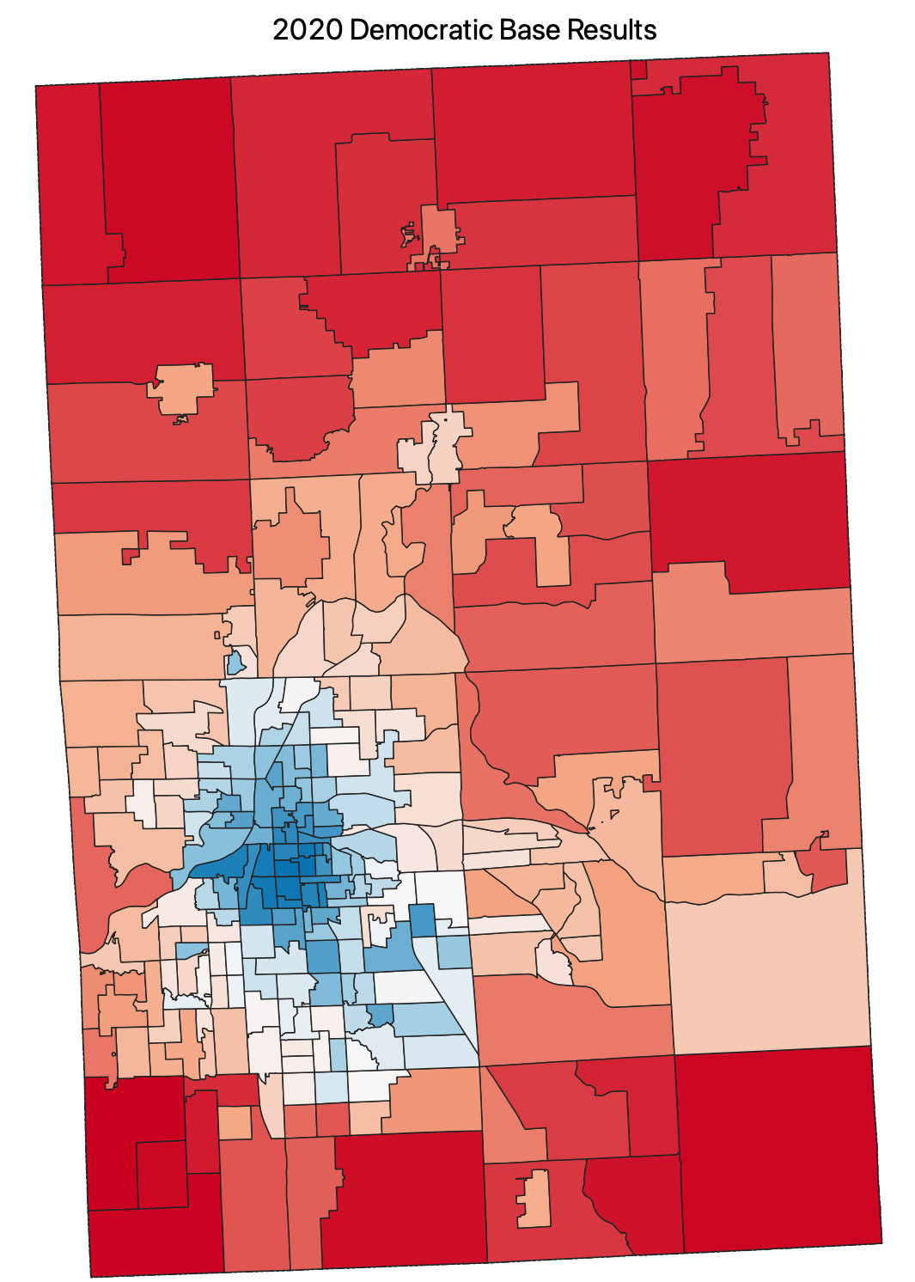
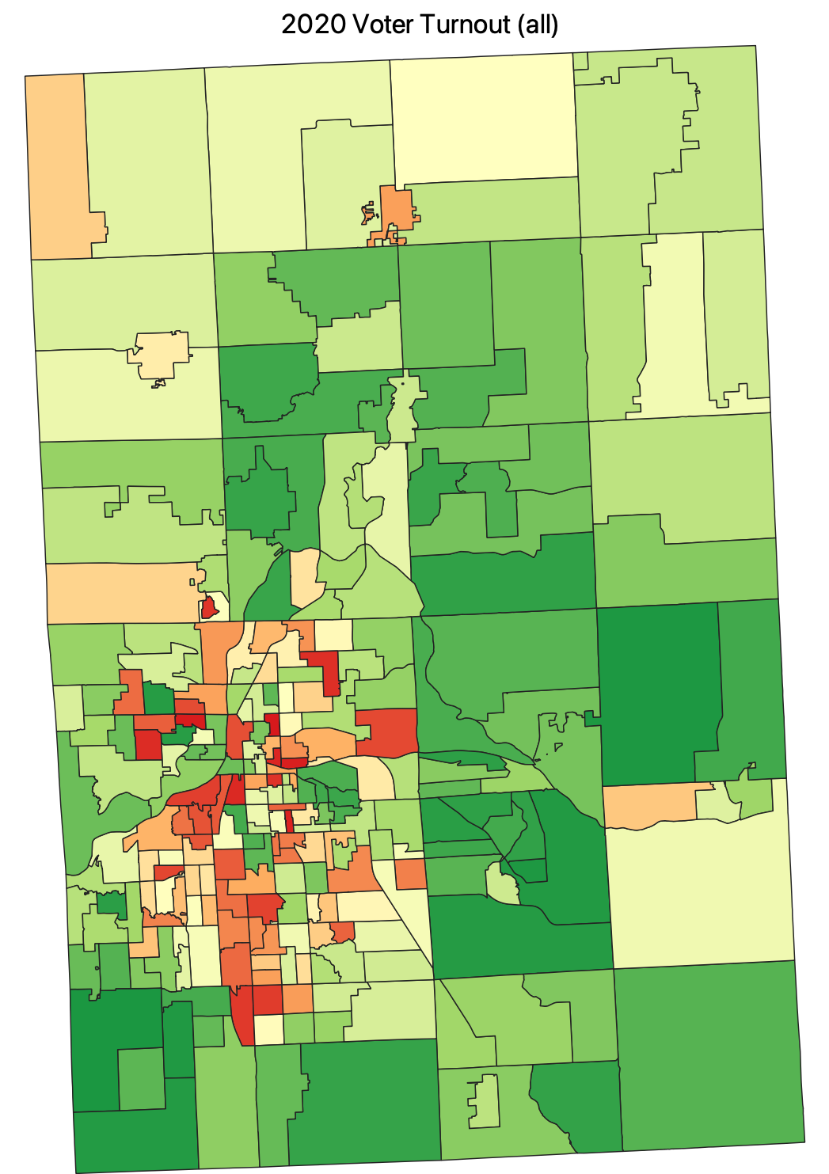
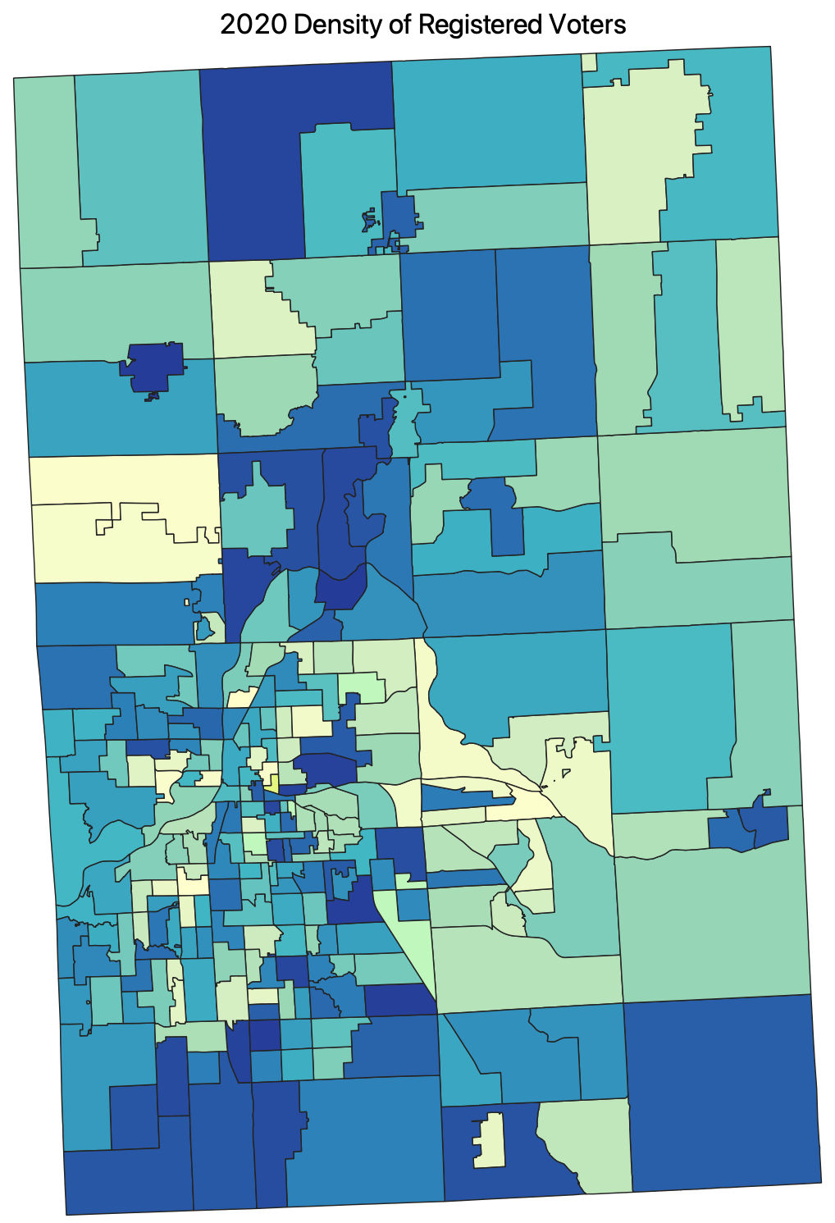
Know your precincts / data
Notes:
Recruiting Best Practices - Know the data, know the seats
The more that you know about any given seat, the precincts that make-up each seat, etc.…the better to inform, prepare, and recruit a potential candidate to that seat. So, try to include as much of this type of data into your plan so that everyone who is working on recruitment can share and build on this data to recruit the best candidates to run for office. Much of the data compilation work that you can do earlier in this process before recruiting candidate – you can eventually share with your candidates to save them from having to start their research from scratch.

Slide 8
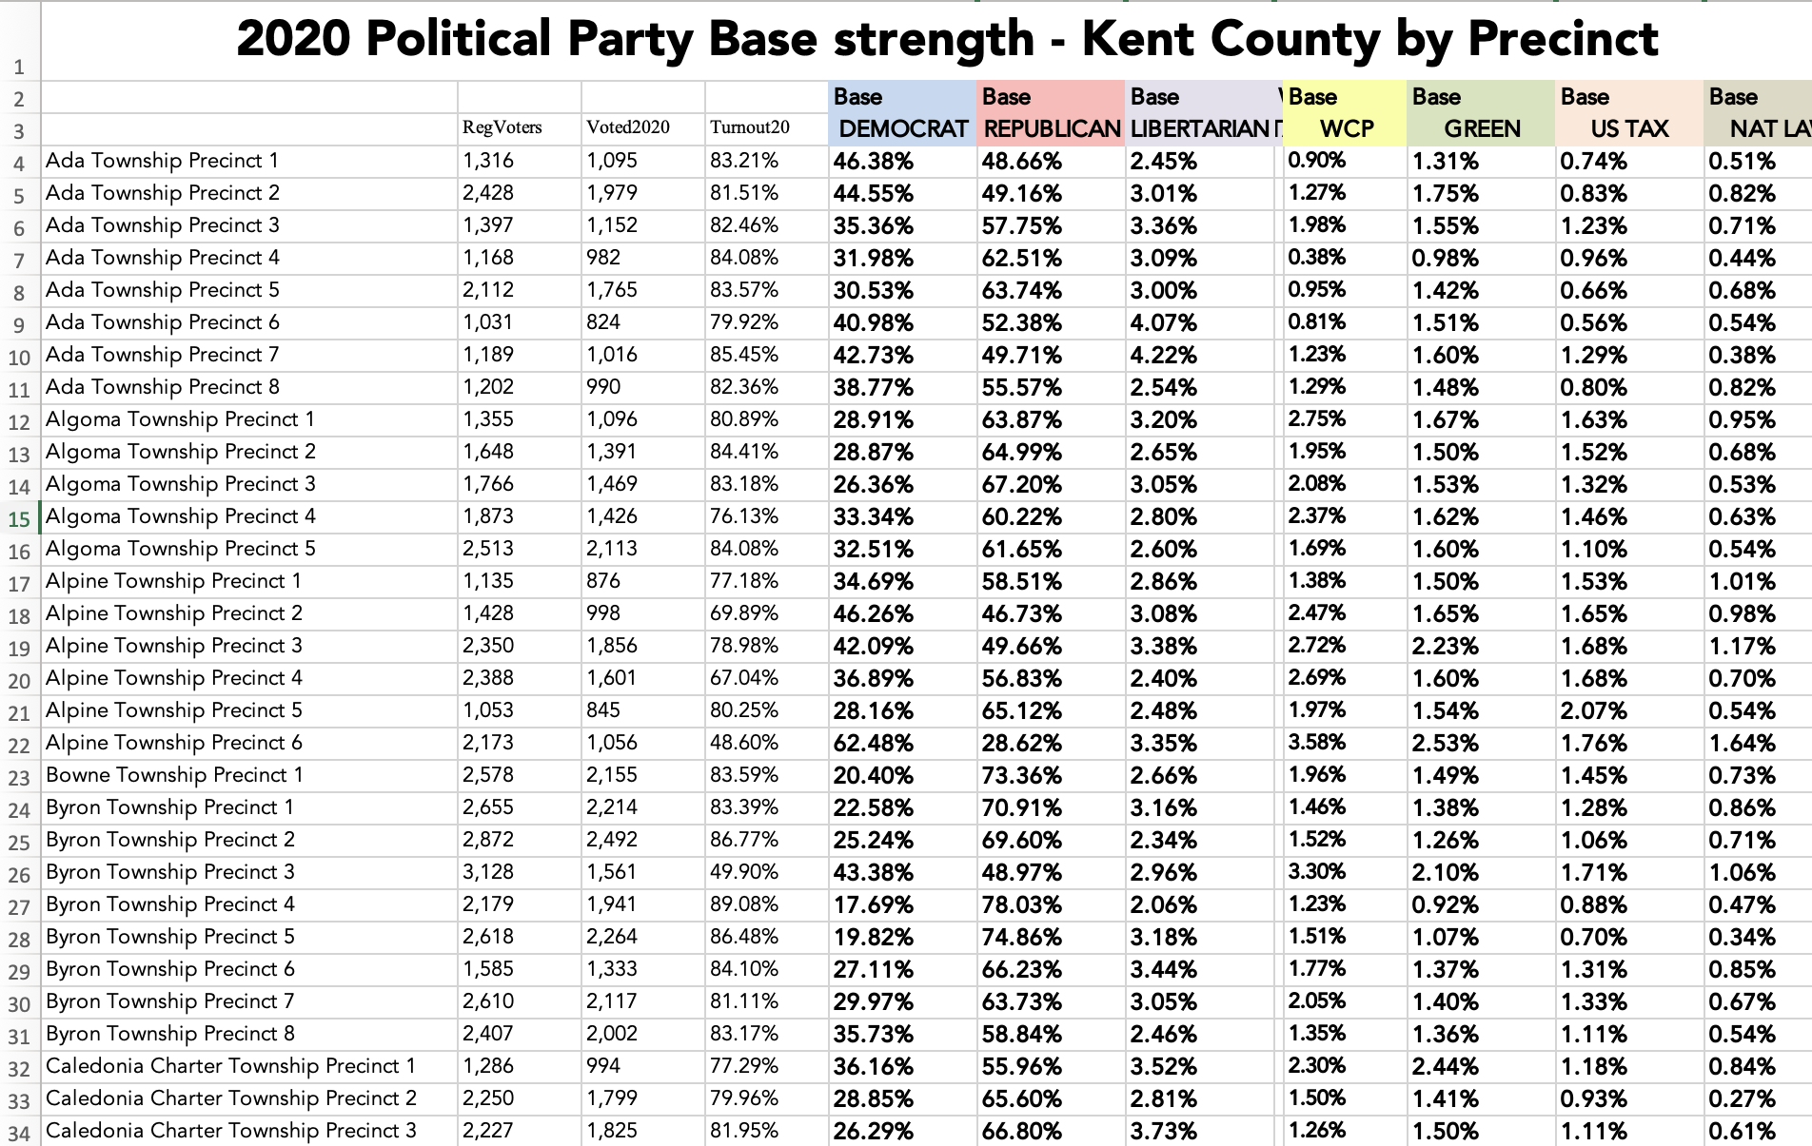
Know your precincts / data
The important thing is to know where your voters are, how they turnout, and what challenges need to be overcome to pickup or win a seat.
This will help any potential candidate get a feel for the work ahead.
Notes:
You do not need to be as fancy as the maps. Including the appropriate data in any format is sufficient (spreadsheets, notes, etc.) Personally, I am a big fan of visualized data – it helps people get an immediate grasp of the data which is very helpful in recruiting. But it is not necessary at all. A comparison chart or table of various data points works as well. The bottom line is to compile the data into a sharable plan. Use collaborative tools like Google Drive, Google Sheets, etc. and share the workload and burden of tracking down the data. I also recommend appointing one person to be the “gatekeeper” of the data – to be the one to invite others, provide access, and manage the security of the online file – but more importantly, to set the data conventions and standardization rules to keep the data clean and consistent.

Slide 9
Planning the Guide
Begin by selecting the format in which the guide will be put together. This is not meant to be an ad hoc task.
Consider using a google doc or google sheet. This will ensure that the document is accessible to multiple people within the organization.
Share the responsibility across multiple individuals. Consider setting up a committee or work group. Assign individuals to gather the information by municipality or group of municipalities.
Notes:
These have already been mentioned in passing – but are worth their own slide.

Slide 10
Notes:
Bench building should include plans to make your bench a strong bench. You can strengthen your bench by keeping these recruits engaged – working within the party, volunteering on other campaigns to gain campaign experience, attending candidate trainings, learning how to raise funds, etc. Basically, gaining the skills early so that they are more effective and seasoned campaigners by the time they are ready to run. Work with your Project83 organizer. We can connect candidates and bench recruits to local or online candidate trainings or get them plugged in to other races that may be going on within a region.

Slide 11
Questions?
Notes:
Questions?

Slide 12
Candidate Recruiting 101
Notes:
As mentioned at the beginning of Bench Building – candidate recruitment is similar, but not the same. Candidate recruiting is to recruit a candidate to run for a specific office at a specific time (cycle). This is much more targeted than building the bench. The first step to recruiting candidates is to start by looking at your bench to see if you already have someone ready who meets the needs of a seat that you are recruiting for. For example, let's say that you are recruiting for a county Prosecutor seat. Your first stop would be to see if any of the folks on your bench are attorneys, law enforcement, etc. who would/could be qualified to run for Prosecutor,.

Slide 13
Notes:
#TRUTH To put this another way… YOU LOSE every seat that you leave unfilled by a candidate. We don’t want to roll over and go all belly-up to let the Republicans trample over us. We shouldn’t give them a free pass on anything.

Slide 14
Candidate Recruitment
Two distinct types of recruitment:
Finding a new individual to run for office.
Finding an elected official to run for a different elected office.
Every candidate recruitment program run by a local party should include both components.
Because building the bench means continuously moving elected officials towards higher office, parties should have ongoing follow up conversations about the desire of their elected officials to run. It is best practice to keep ongoing succession plans for seats.

Slide 15
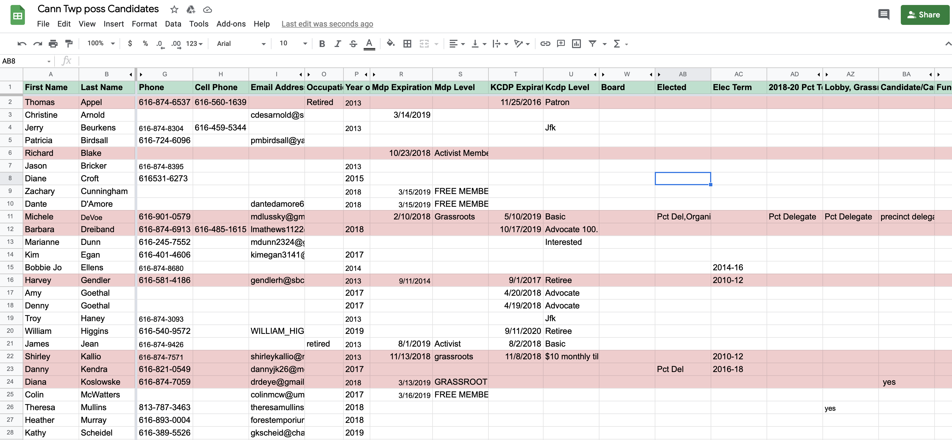
Notes:
So now we have the Public Office Guide – now we need to start a candidate recruiting tracker to track prospects or candidates for all the seats identified in the first step. This is also a great place to keep data or notes for future cycles (more bench building) Just like the Public Office guide that you created in the Bench Building more data is better. Your candidate recruiting tracker should have as many notes as possible or data points to help effectively track prospects and recruits. This example is for Cannon township in Kent County. I recommend a separate sheet or tab for each office that you are recruiting for. Start with researching possible recruits and logging them in the tracker… rank them however you feel is best… then start the process of working down the lists to have the conversations with potential recruits. Some may not have any interest, some may be great candidates for your bench, and hopefully – you find the candidate for the seat you are working to fill.

Slide 16
Candidate Recruitment
Nonpartisan
Local School Boards / Community College Trustees
Local Municipal offices (Cities & Villages)
Local Library Boards
Judicial seats (Local District or Circuit courts)
Partisan
Township offices
County Commission offices
Countywide offices
State Legislative offices
Notes:
We are Democrats – but we should be recruiting for nonpartisan offices as well as partisan offices. Another bench building tool.

Slide 17
Candidate Recruitment
State Legislative Offices
Be sure to communicate or partner with the House or Senate caucuses. They are also working on recruiting these seats.
House Dems | Senate Dems
Maryli Secrest | Ben Miller
msecrest@mihousedems.com | bmiller@senatedems.org
Notes:
Always know, you are NOT the only ones out there recruiting. The more that you communicate with our partners and caucuses, the better the recruiting process will go, and you can reduce the possibility of unintended primary races. As soon as someone approaches you wanting to run for a State House or State Senate seat… make sure that you alert the appropriate caucus leader.

Slide 18
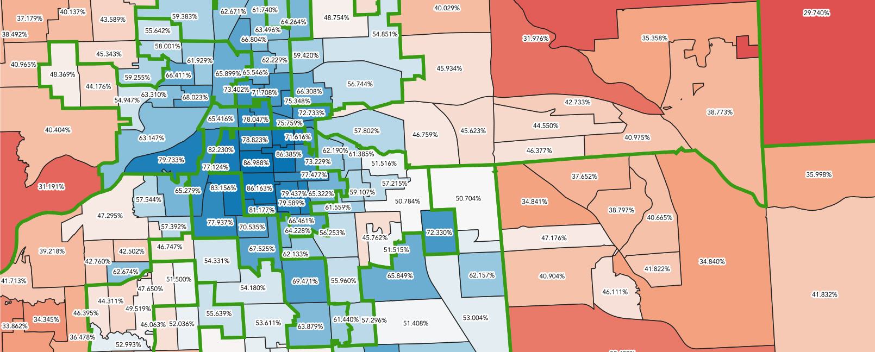
Candidate Recruitment
Notes:
As a redistricting year – and with redistricting data arriving six months later than normal… we are faced with additional recruiting challenges. Data is your friend. This map is a prime example. The color ramp gives a visual representation of the 2020 Party Base. (Base numbers are calculated from the Board of Ed and University boards… do look to Presidential / Gubernatorial performance as a basis for Dem Base or strength). The green lines in this map are current County Commission boundary lines. Unlike a traditional year where you are looking to recruit for individual seats…

Slide 19
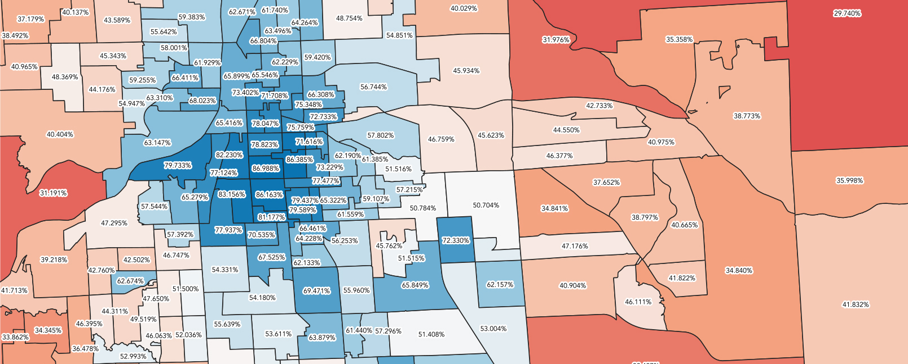
Candidate Recruitment
Notes:
Look to identify possible candidate or bench recruits from communities or neighborhoods rather than from within the current, existing lines. Be cautious to avoid recruiting on top of sitting Democratic office-holders. We are months away from knowing what the new lines will be. Don’t let this hamper your recruitment efforts. Now you can see why there was such a strong emphasis on local data earlier. The more that you know, the better you will be at recruiting the best candidates for each seat.

Slide 20
Candidate Recruitment
Where to look
Civic organizations
Labor unions
Community activists
Business leaders
Professionals with relevant experience
Current & past officeholders and candidates
Diversity
Work with constituency groups to ensure we are running candidates who are as diverse as our party. (labor unions, NAACP, Hispanic Centers, LGBTQ Organizations, Community Engagement groups, etc.)
Notes:
Now for the nuts and bolts. The question I get most often is… where do I find or identify potential candidates. Start by having conversations with a wide variety of folks from like-minded organizations, community groups, etc. We are looking for much more than a warm body to run for offices. Finding the best person to represent their community takes work. Ultimately, we are recruiting potential policy-makers and representatives of the people.

Slide 21
Candidate Recruitment
Where else to look (Prospecting)
Party membership lists
VAN (Votebuilder)
SoS Donor search - http://Michigan.gov/sos
Recruiting tools
1:1 meetings
Online sign ups
Committees or working groups
Notes:
As you get deeper into the recruiting and start running out of ideas – there are some tools that you can use to prospect for more. Let’s look at these starting with the lowest-hanging fruit… your county or MDP membership lists. Members of the party are the easiest to approach and have a vested interest in Democratic representation. I have found that just reviewing member lists has reminded me of people I had forgotten about. This should be your first layer of prospecting. We’ll cover VAN and Sec of State in just a moment.
Other prospecting tools could be an online form on your county or district party website for people to express interest. An email plea to membership, etc encouraging members to fill out the form, forming committees or groups to fan out throughout the community to help identify potential prospects, or just sitting down for one-on-one meetings with potential prospects and smiley talking through the idea of their running for office with them.

Slide 22
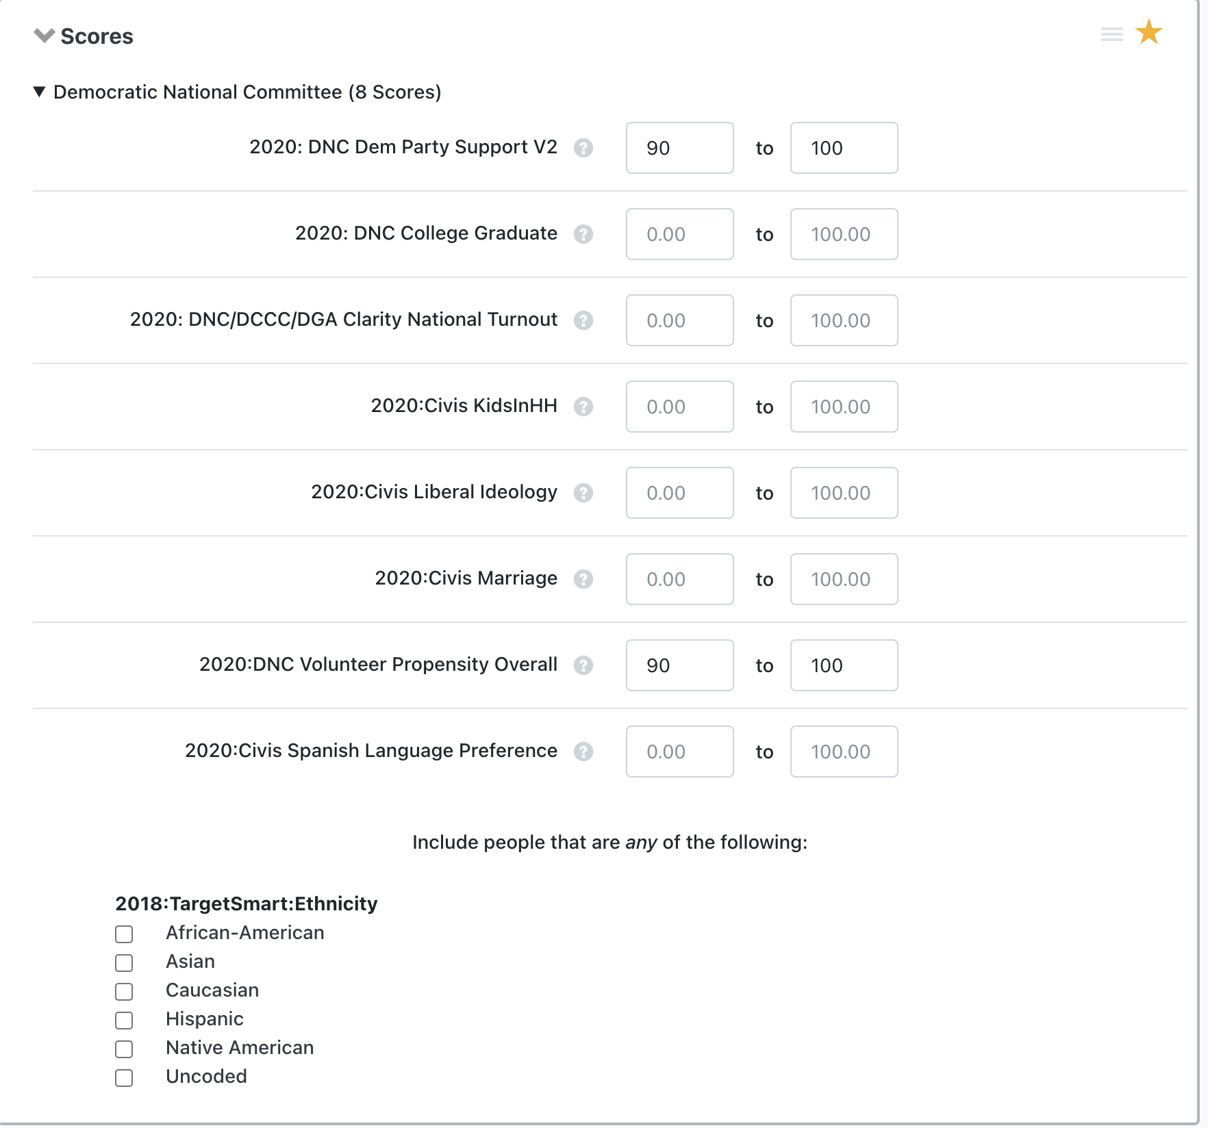
Candidate Recruitment
VAN Prospecting
After selecting your County and the District…
Try pulling a list by SCORES of voters with a 90-100 DEM Party Score who also have a 90-100 Volunteer Propensity. (Also, a great way to reach out to potential new party members to invite them to join your local party).
Based on the results of this search, adjust the scores higher or lower to generate a manageable prospecting list.
Notes:
Cold-calling prospecting… Identifying new potential prospects or local party members. The big ancillary benefit of calling High Dem Score prospects – if they have no interest in running for office – you have the opportunity to invite them to engage with your party, invite them to meetings, etc. Since you have them on the phone to talk about running for office – even if they turn you down you can always fall back on growing your local party.

Slide 23
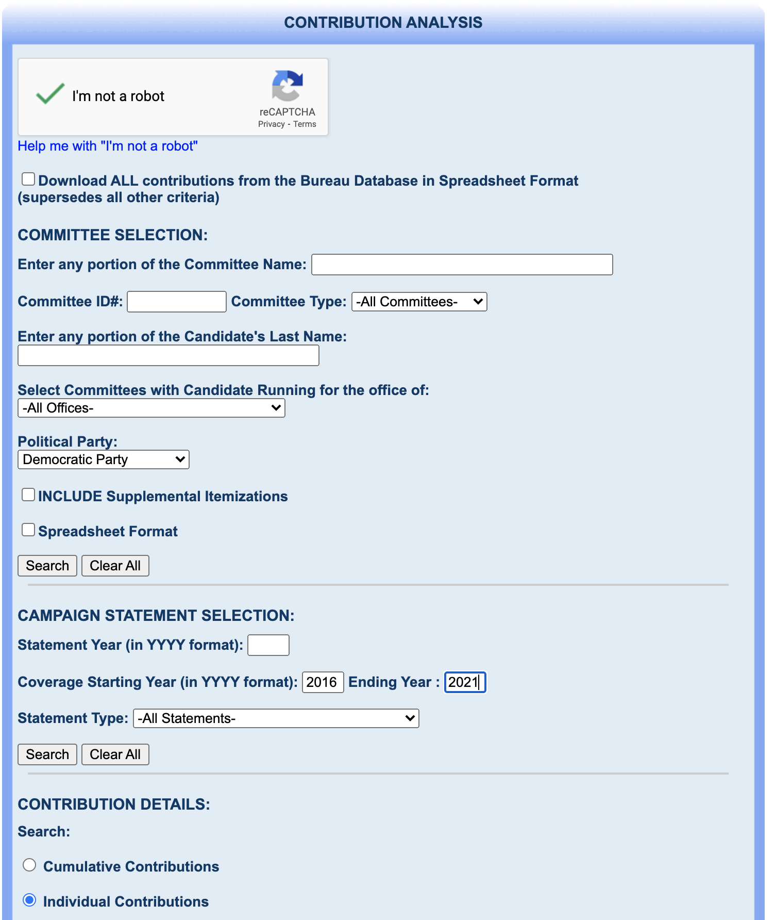
Candidate Recruitment
Sec. of State Donor search http://Michigan.gov/sos
CONTRIBUTION ANALYSIS allows you to search contributors to political campaigns. Rather than looking at a specific candidate committee to see who contributed. The Contribution Analysis allows you to search for donors to ANY DEMOCRATIC CANDIDATE *. You can narrow that list to particular cities or zip codes, etc. to identify where donors live.
This is just another tool in your box to identify potential candidates and other Democrats or like-minded folks in your counties or districts.
* Sec. of State donor data only applies to State-level offices.
County-level or local offices report finances to the County Clerk.
Notes:
And this applies for any outreach that you do with donors, etc. With donor prospects for recruiting – invite them to engage with the local party but DO NOT ask them for funds on this call. You already know that these prospects are Democratic donors. But do not exploit that on your intro cold call. It is rude, bad form, and could drive them away from participating. Use this as an opportunity to meet them, build a relationship, invite them to events or find ways for them to engage… once you build the relationship, then you can begin making financial asks. I cannot emphasize enough… build the relationship before asking for money. If you already know this person or already have a relationship – knock yourself out and go for the ask. But if it is a new prospect. Put your time in and earn the financial ask. Don’t get sidetracked. You are prospecting recruits or for your bench. Stay on task even f they are donors.

Slide 24
Candidate Recruitment
The only way we will gain territories and flip “red” seats
to “blue” seats… is when we compete in EVERY race…
EVERYTIME!
Use nonpartisan races to build your bench and the names
And experience of your office-holders / future candidates.
Flipping districts takes time, diligence, and perseverance.
Find a volunteer to run even in the reddest of red districts.
Sometimes lightning strikes. You don’t want to waste an
opportunty or give the Republicans anything for free.
Give Democrats who live in Red Zones a choice on the ballot.
Notes:
Back in the day, we used to lovingly refer to certain seats as, “No way in hell” seats. Even in the 10% Dem Base seat… we want to give Democrats who live in that district a choice. In cases like this, we recruit someone who is willing to run. If we can not find someone willing to run a campaign – we will fall back to a volunteer to place their name on the ballot to give fellow Democrats a choice. There is a huge importance to this. Empty spaces on the ballot cause more ballot or voter drop-off. Wherever there is hole in a ballot – all races below suffer from voter drop-off.

Slide 25
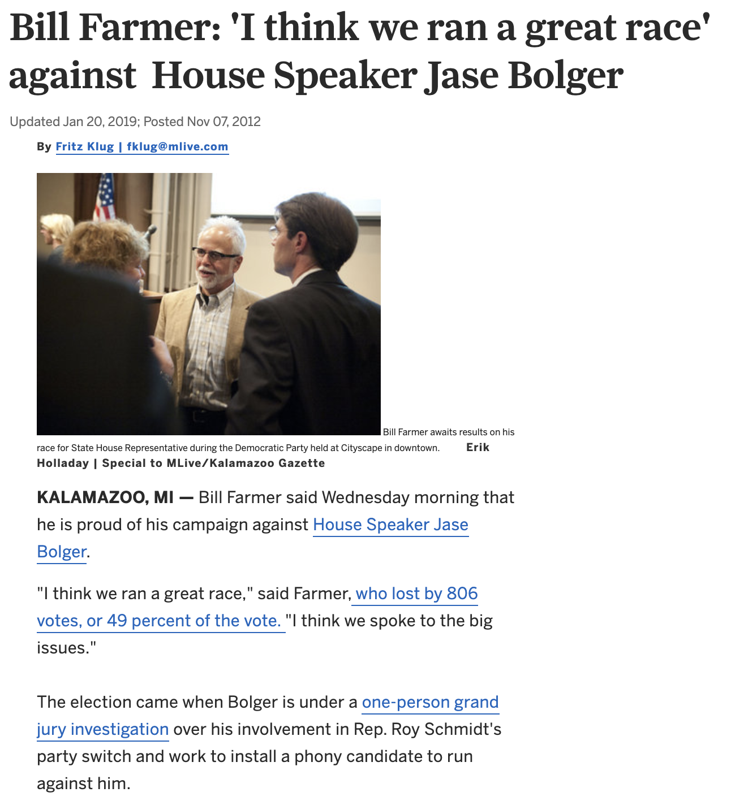
Candidate Recruitment
Bill Farmer comes within
806 votes from unseating
The Speaker of the House
Bill Farmer received more votes
than Barack Obama in HD-63
Notes:
Here is the story of how “a No way in hell candidate” Bill Farmer volunteered to have his name on the ballot against the Republican Speaker of the House and nearly won! Lightning does strike. I have other examples of seats that we picked-up simply by making sure that we had a candidate in place, even in areas that we wouldn’t have otherwise been competitive. But I use this example because I was the one who recruited Bill. He literally agreed to run as a favor. He had no intention to run. We didn’t do any polling – we had no idea that Bolger was vulnerable. MIRS News out of Lansing dropped a poll in that district to show that Farmer was within striking distance. That poll was three weeks before Election Day. In three weeks we blanketed the district with yard signs, hit the doors, and started a campaign from zero. Imagine what could have happened if we had a few more weeks to talk to voters or to get Bill’s name out.

Slide 26
Candidate Support
One of the most important functions of any party is providing material, logistical, and institutional support to our candidates.
While local parties are encouraged to develop support programs, MDP presently offers the following:
Access to valuable voter file & targeting data through the VAN.
Access to gang run printing
Valuable partnerships:
Website and graphics support
Targeted web ads (dspolitical www.michigandemads.com)
Material printing (Lawson Printing, Inland Press)
Technical campaign assistance (Project 83):
Field & campaign plan writing
Communications
Data
Finance
Notes:
Project83 is here to help your recruits. We have training programs like NDTC, Regional MDP candidate trainings, Great Lakes Political Academy, etc. that we can help candidates with. And as MDP we offer some additional support and cost-saving programs. As a party, we do not directly fund campaigns, but we do provide campaign support, opportunities, and tools to help all candidates up and down the ballot. We also help integrate down-ballot races with the OneMichigan Coordinated Campaigns.

Slide 27
Questions?
Notes:
Questions?

