Slide 1
Using Actblue

Slide 2
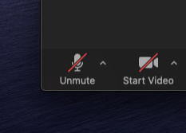
Zoom
Please be muted unless you have a question or comment

Slide 3
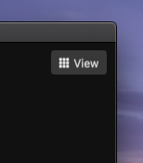
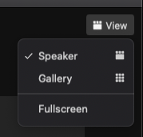
Zoom
Click “Speaker View” so that you can see my screen

Slide 4
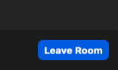
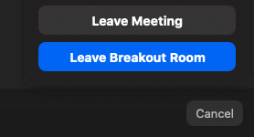
Zoom
Return to main room before next set of breakout sessions

Slide 5
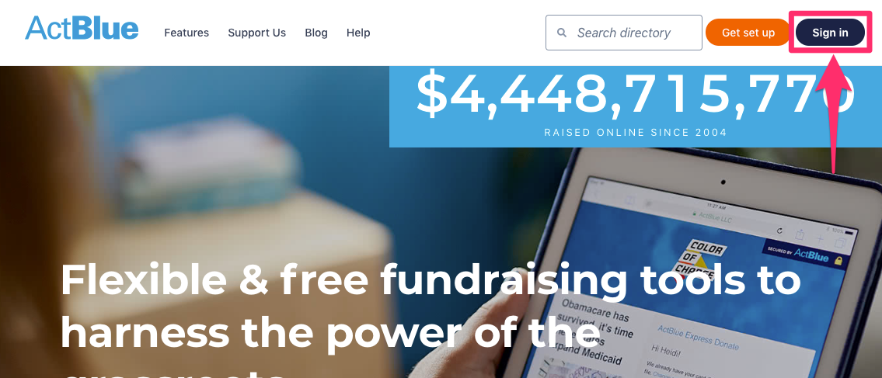
Setting up an Account
What kind of organization are you?
Candidate
Other Political Org.
State and federal PACs, ballot initiatives, 527s, etc.
501c3
501c4
Once you setup your account, Actblue will send you an email to login
Login in to your account using the “sign in” button on the top right of the screen

Slide 6
Navigating Your Account
Recent Menu
Clicking on this shows your pages you recently visited
Dashboard Menu
A list of campaigns and orgs you are an admin for
Manage Menu
Personal contributions you make
Important account settings
Change password
Enable two-factor authentication
Manage email alerts

Slide 7
Navigating the Dashboard
Quickly analyze all of your fundraising data and create new contribution forms
View fundraising data from custom time lengths
Quickly view where contributions were made from
Did you raise more, less, the same as last week/month etc.
Mobile contribution vs. other

Slide 8
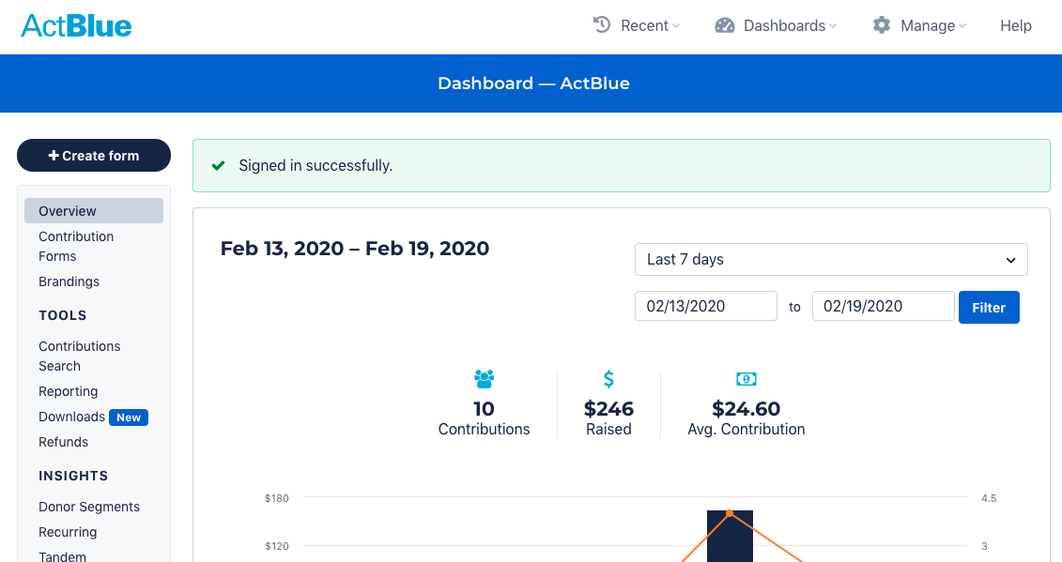

Slide 9
Tools Section
Contributions Search:
Your center for finding every contribution made to your group through ActBlue
Reporting
Contribution data you’ll need to complete accurate compliance reports
Downloads
The place to create downloadable CSV reports of contribution data sorted by time period or contribution type
Refunds
All refunds made by you and AB Customer Service team in response to donor errors and credit card chargebacks, which you need for compliance reports

Slide 10
Insights Section
Donor segments
Access, visualize, and download donor data
Create targeted lists
Recurring
Find data on recurring contributions and download CSV files of active recurring contributions, recurring projections, or cancelled recurring contributions
Tandem Fundraising
A list of other campaigns and organizations receiving contributions on Tandem Fundraising forms you make

Slide 11
Admin Section
Settings
Where you can update your campaign or organization’s contact information and your mailing address
User Access
Where you can add team members to your campaign or organization’s account
Email Alerts
Where you can set up email notifications letting you know when your group receives a donation or refund over a certain dollar amount so you can be aware of big numbers without digging through the data manually

Slide 12
Creating a Form
Contribution form
Event form
Merchandise form
Duplicate existing form
It will ask you form title, web address, and customer service email

Slide 13
Contribution Form Cont.
Title, Ask, and URL
Always create a custom title and ask
Preset Donation Amounts
Separate with a comma
Thanks and receipt

Slide 14
Downloading Contributions

Slide 15
Sign into your Act Blue Account
Your page may look different than this one

Slide 16
REPORTING

Slide 17
REPORTING CENTER
PICK THE MONTH YOU WANT TO DOWNLOAD
THEN CLICK ON CVS DATA ON THE RIGHT SIDE

Slide 18
DATA WILL BE SAVED IN CSV FORM
YOU CAN CHANGE WHAT DATA YOU NEED BECAUSE ACTBLUE USES MANY FIELDS.
MAKE SURE THAT YOU SAVE THE FOLLOWING;
THE COMPLETE NAME, ADDRESS,CITY,STATE, ZIP
ADDITIONAL FIELDS YOU MIGHT WANT TO SAVE ARE:
OCCUPATION, EMPLOYER, EMAIL AND PHONE NUMBER.

Slide 19
ActBlue Form - Branding
Hannah King - Director of Digital Organizing

Slide 20
It’s all in the Branding Tab
Everything in this section will be in the “Branding” section of the Edit Form page
Except for Social Share
This section allows you to customize most of your form’s:
Layout
Colors
Fonts

Slide 21
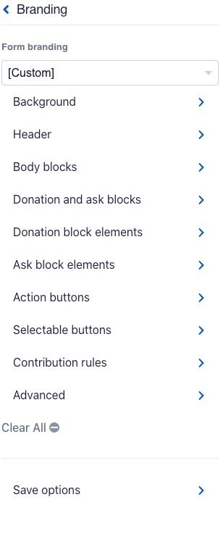
Background

Slide 22
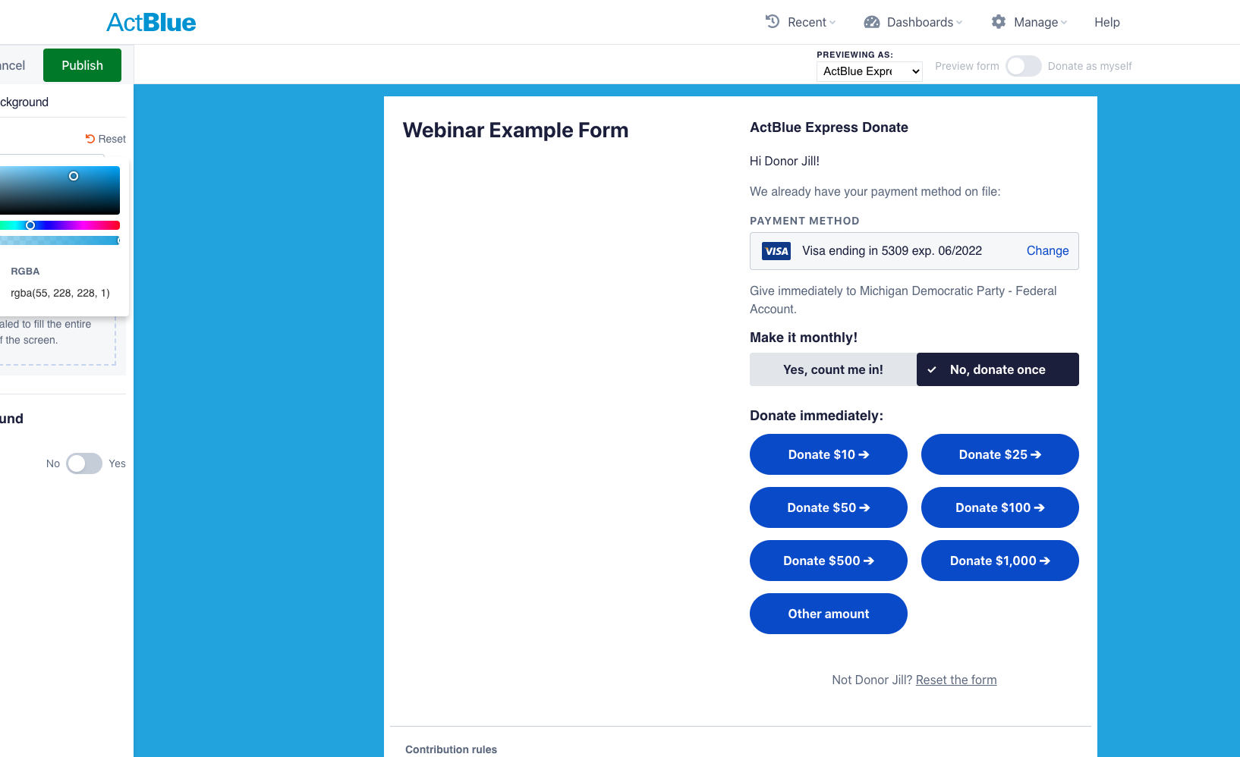
Color
MDP Colors
Light blue: #37aee4
Navy Blue: #02273F
Red: #F90040

Slide 23
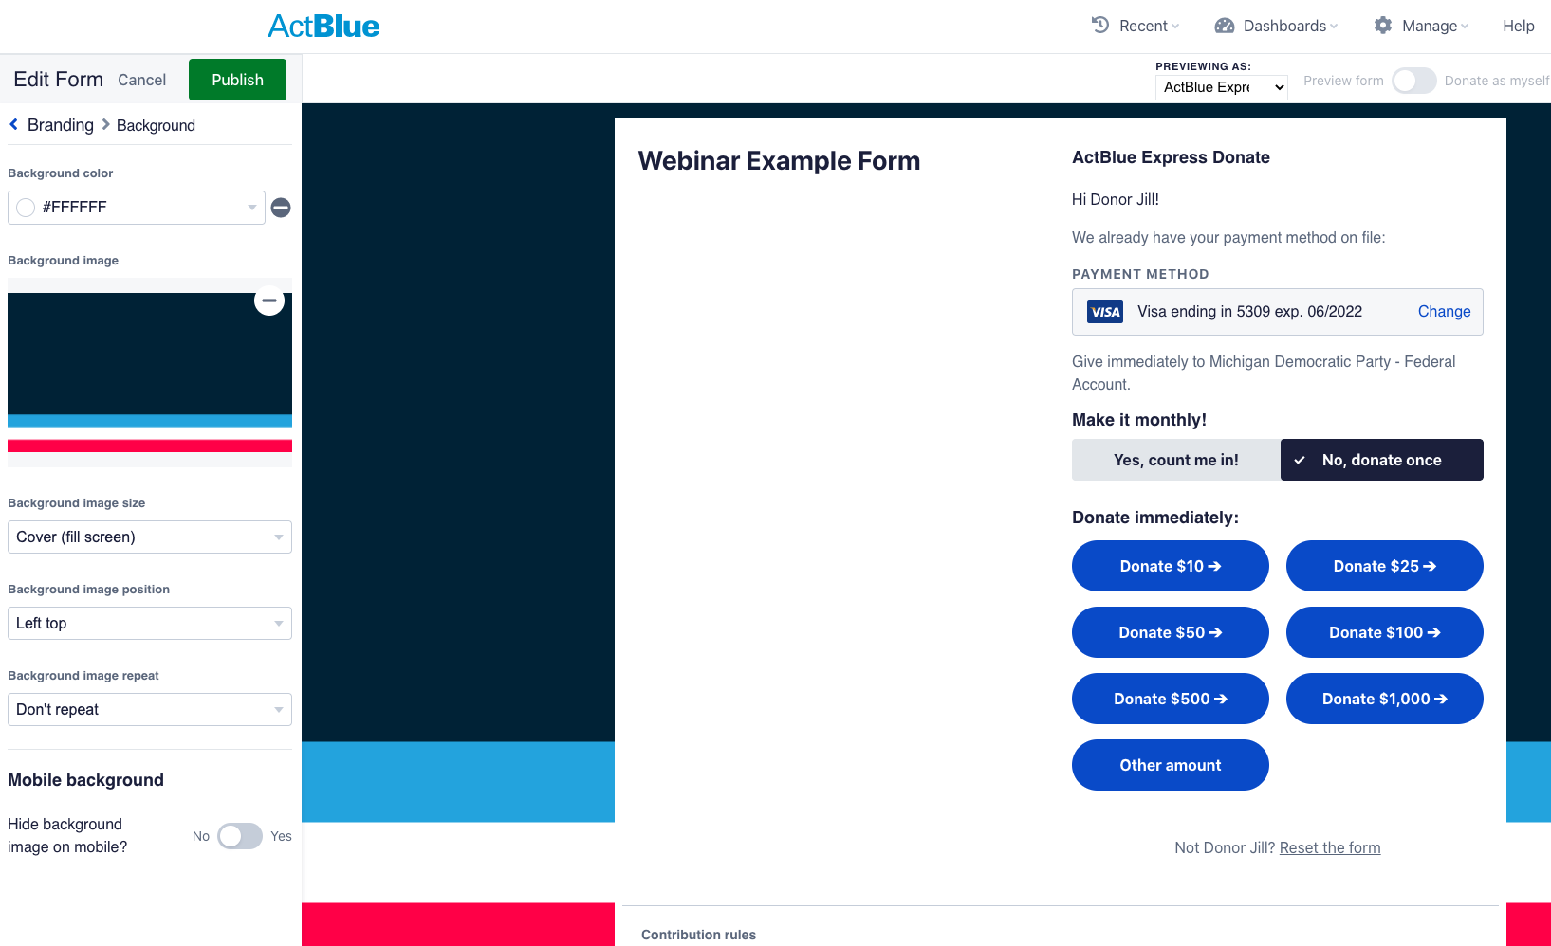
Image
Upload an image to fit the background of the screen
Make sure nothing gets cut off (check mobile)
Keep it simple
Dimensions:
1920 x 1080

Slide 24
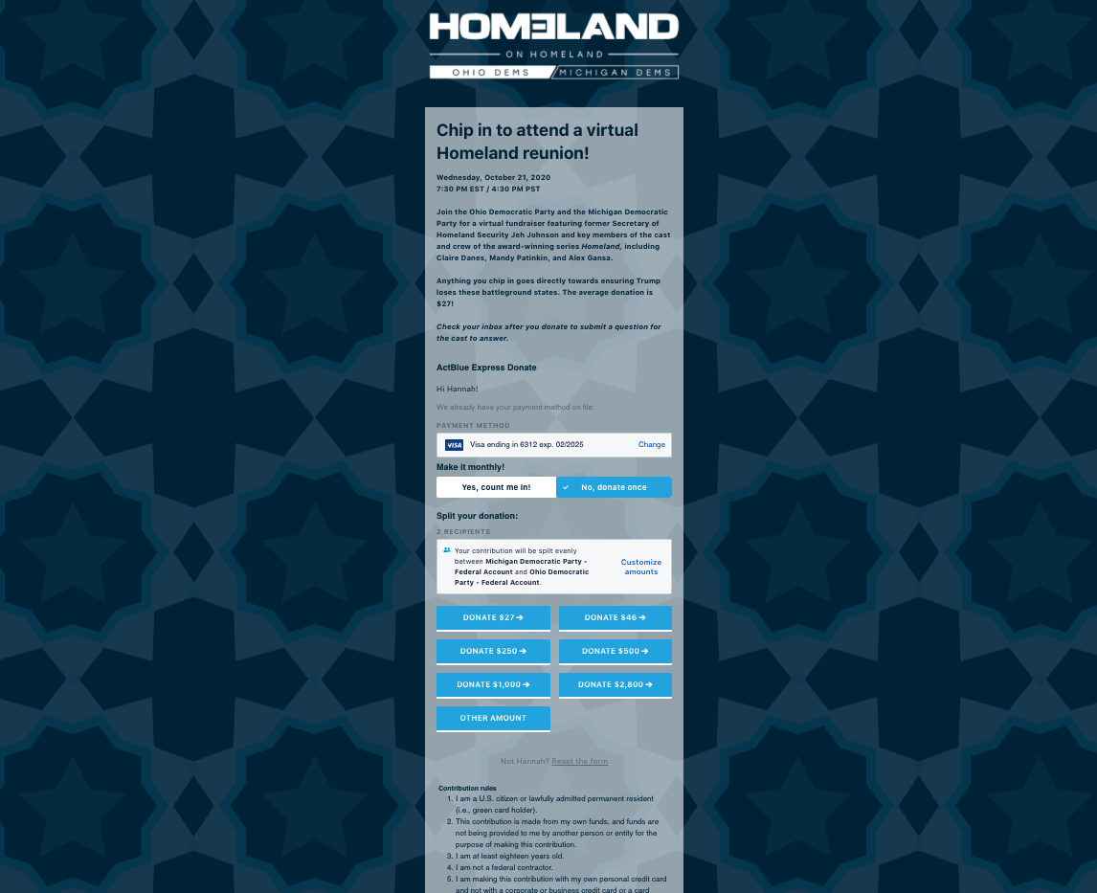
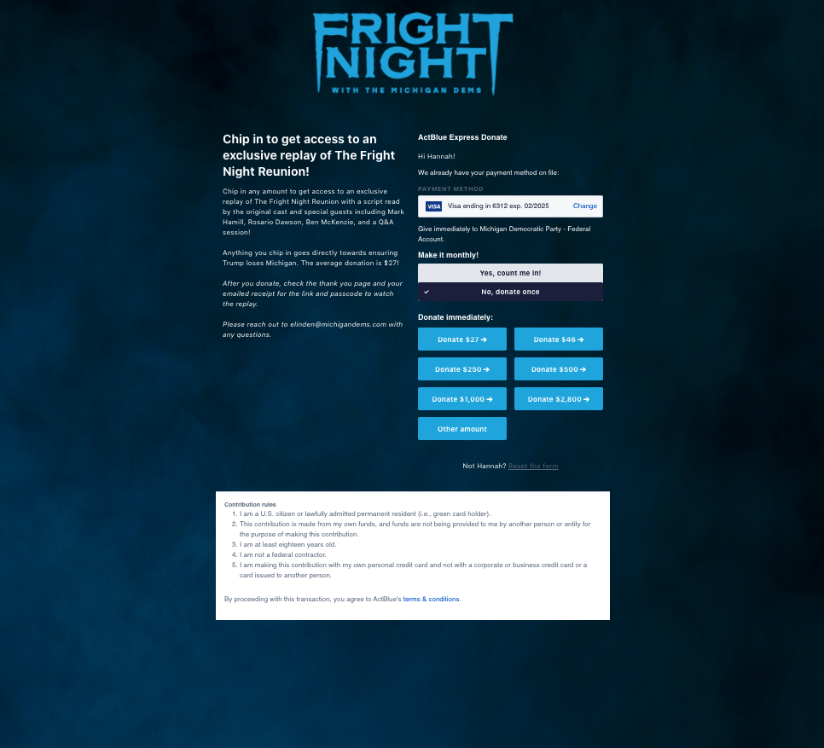
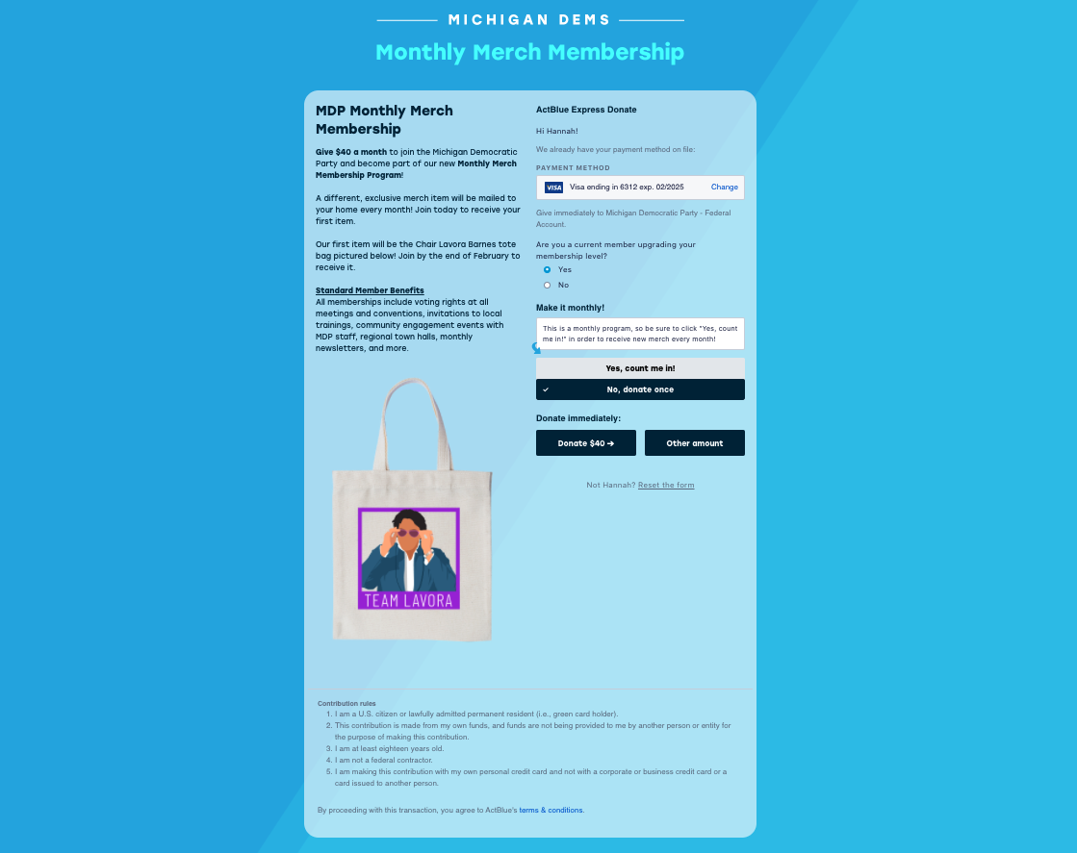

Slide 25
2. Header

Slide 26
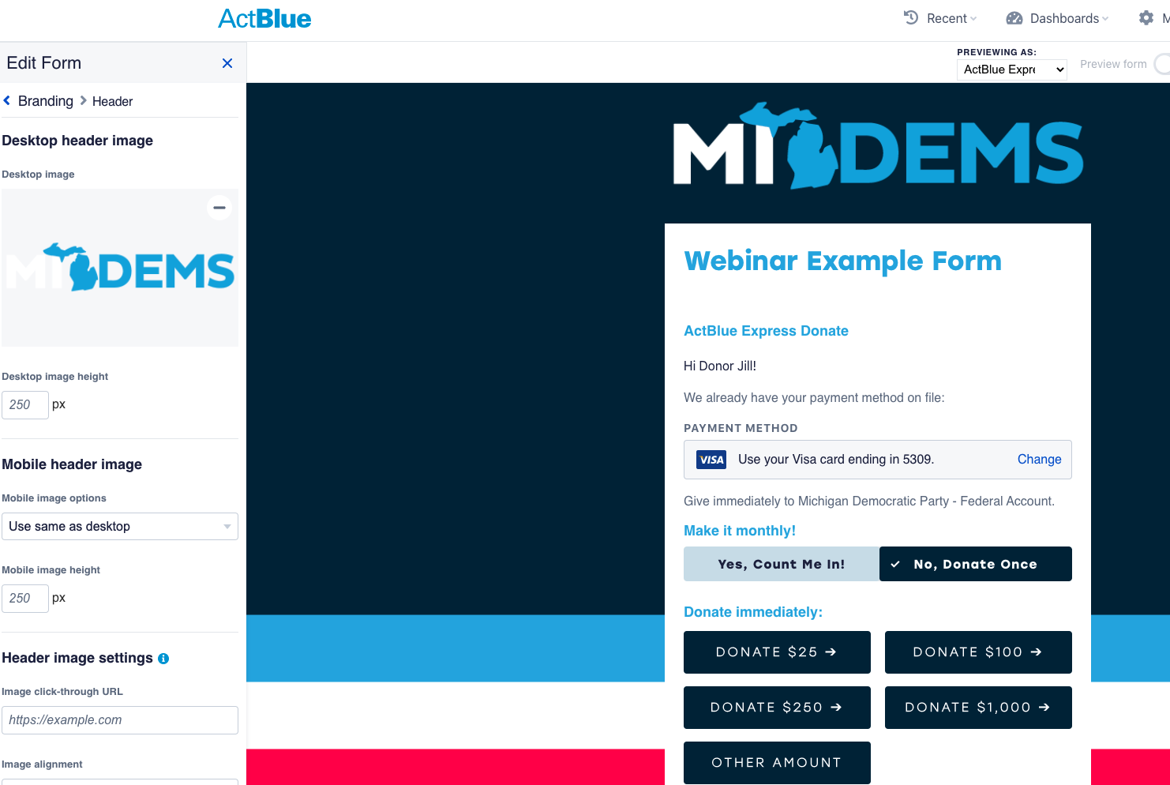
Image Upload
Your logo
Event title
Program title

Slide 27
3. Body Blocks

Slide 28
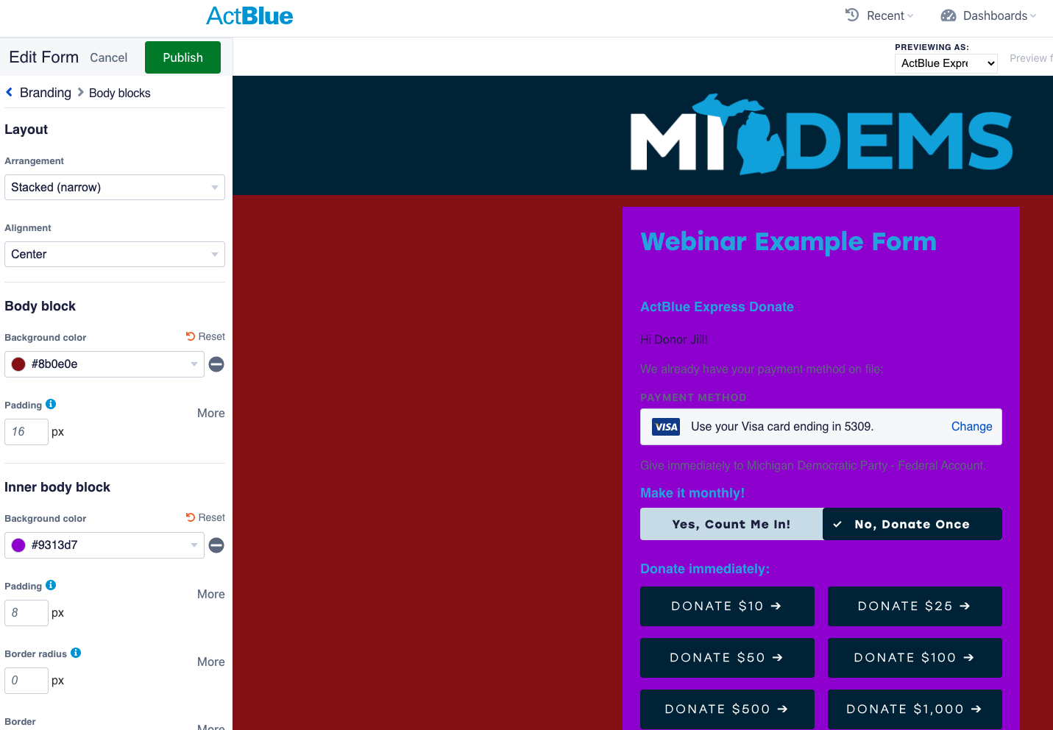
Wide or Narrow
Alignment
Background color will cover any image
Inner body block
Light/white
Readability of the text
Transparency

Slide 29
4. Donation & Ask Blocks

Slide 30
As you can see, a lot going on here
There is no reason to change these settings
Busy, readability, distraction

Slide 31
5. Donation block elements

Slide 32
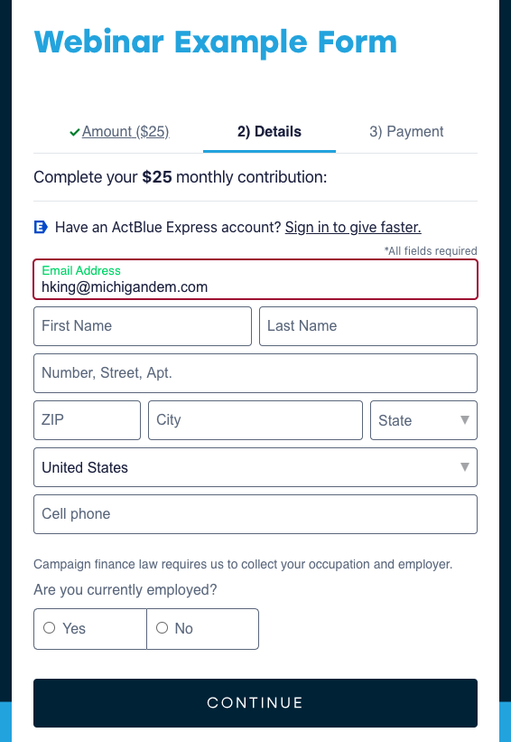
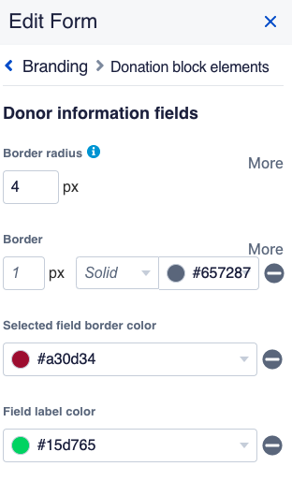
Use whatever the default is or us MDP branded colors
Not something you can preview in the editor

Slide 33
Donation Block Headings

Slide 34
6. Ask Block Elements

Slide 35
Title
Font
Weight
Case

Slide 36
7. Action Buttons

Slide 37
Font
Weight
Case
Radius

Slide 38
8. Selectable Buttons

Slide 39
Selectable Buttons
Selected and Not Selected
Contrast
Default

Slide 40
9. Contribution Rules

Slide 41
Default

Slide 42
Social Share

Slide 43
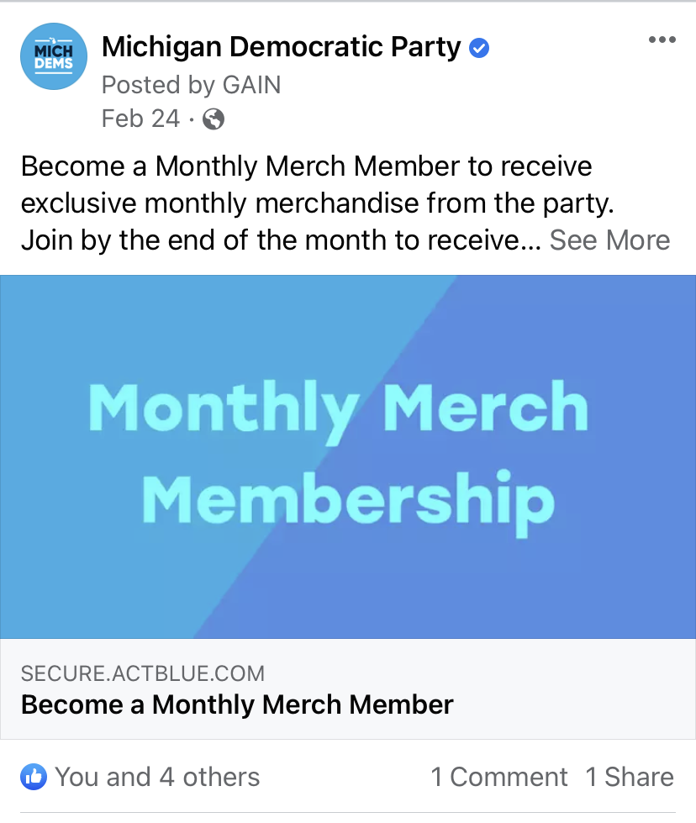
Social Share
Meta Images
What your post will look like if you share the ActBlue Link on Social Media

Slide 44
Notice the default
Notice the dimensions
Use the preview buttons

Slide 45
Facebook title & description
Tweet text, title, description
Different dimension
Can take a while to apply

Slide 46
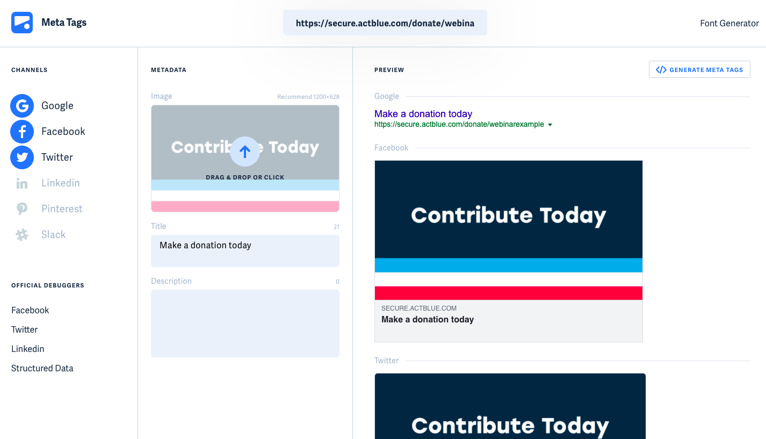
metatags.io
Test your meta image here
Copy and paste the link to your ActBlue page

Slide 47
You got this

